Slide 1
Process Documentation of Serverless Three-Tier Application

Slide 2
Services used for Project
1.AWS LAMBDA
1.Triggers
2.Cloud Watch Logs
2.S3 (Simple Storage Service)
1.Bucket
3.AWS RDS
1.Database
2.CloudWatch Metrics ,Logs & Events
4.Dbeaver
5.Postman

Slide 3
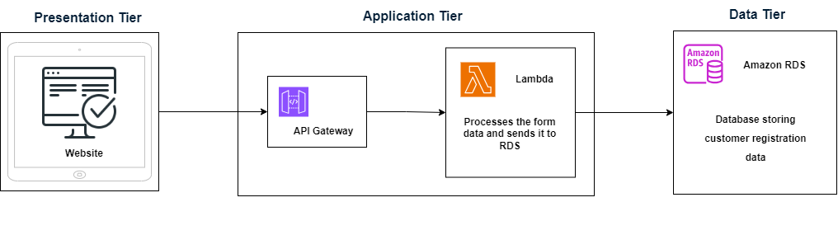
Flowchart of the Project

Slide 4
1.Sign-in to AWS Root Account
1.Search for AWS Management Console in Browser.
2.Open to the AWS Management Console.
3.Click on “Sign In to the Console”.
4.Choose “Root user” as the login method.
5.Enter Email and Password that is associated with your AWS root account.
6.Click on Sign in.

Slide 5
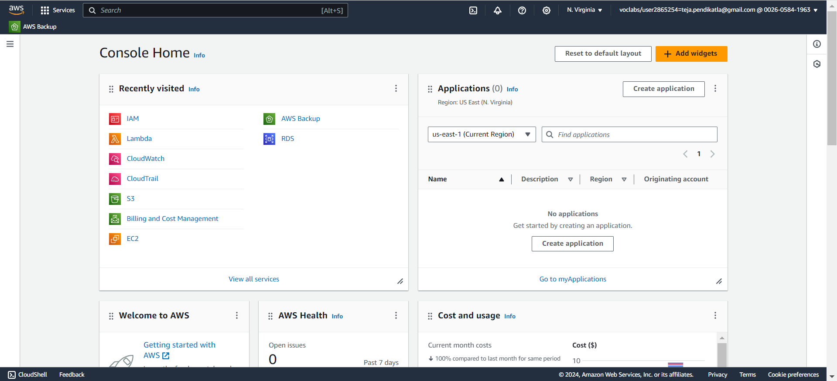
1.1 AWS Console Home.

Slide 6
2.SettingUp Lambda
1.Search for Lambda in Search bar and open Lambda dashboard.
2.Click on Create Lambda Function , Assign a Name to Lambda & Runtime(Language) , Select Architecture as x86_64 , Click on Create a new role with basic lambda Permissions ,Create.
3.Click on Add Trigger , Search for API Gateway , in intent block checkmark on Create new API , in API type block select REST API , in Security dropdown select Open and Add it.
4.Click on Code in Lambda Function , Click on Upload from , select the ZIP file ,click on Upload to Upload the zip file in Lambda function & the code will be Deployed if not Click on Deploy.
5.Click on Configuration in Lambda Function to get API Endpoint & Copy it.
6.Open Postman , Select GET – Paste the API Endpoint, Click on Body – raw ,enter the data that has to Lambda & Click on send to Hit a request to Lambda Via API Gateway from postman.

Slide 7
7.Click on Monitor in Lambda Function ,Click on view Cloud Watch Logs & Open Log groups – “aws/lambda/qwert” to watch the logs of the created Lambda Function.
8.We can see the logs of Hitting Request to Lambda via API Gateway from Postman.
9.When we hit a request from postman through API Gateway’ end point then API Gateway will receive a request from postman with data & now it sends the data in raw body to Lambda Function.

Slide 8
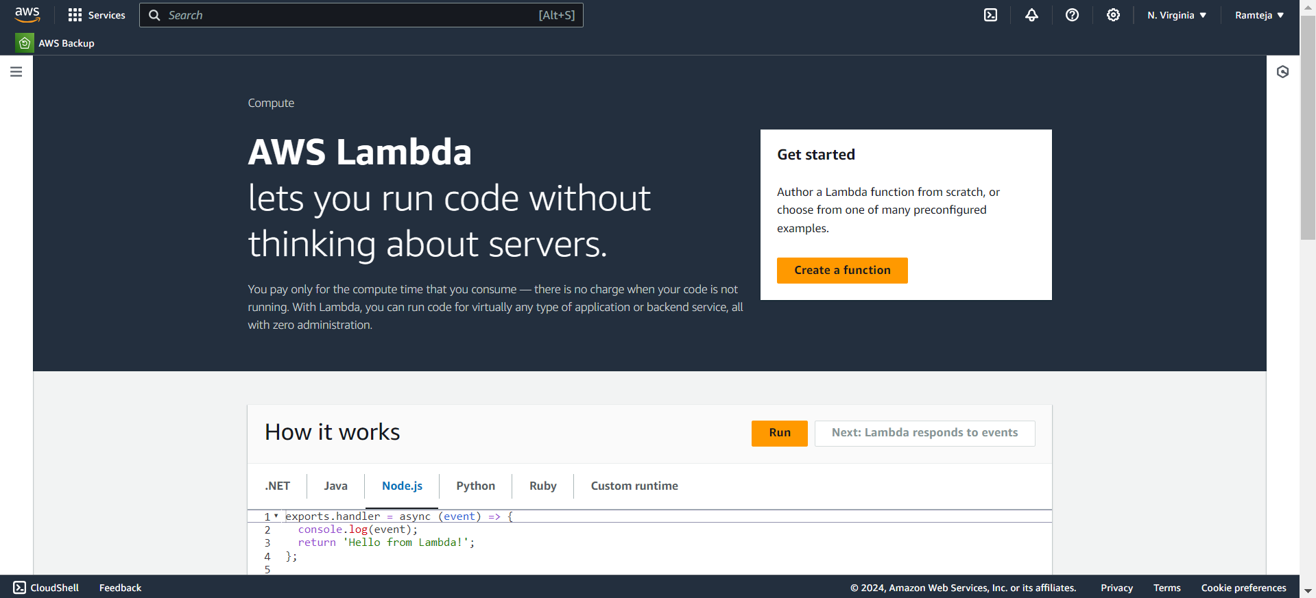
2.1 Click on Create Lambda Function.

Slide 9
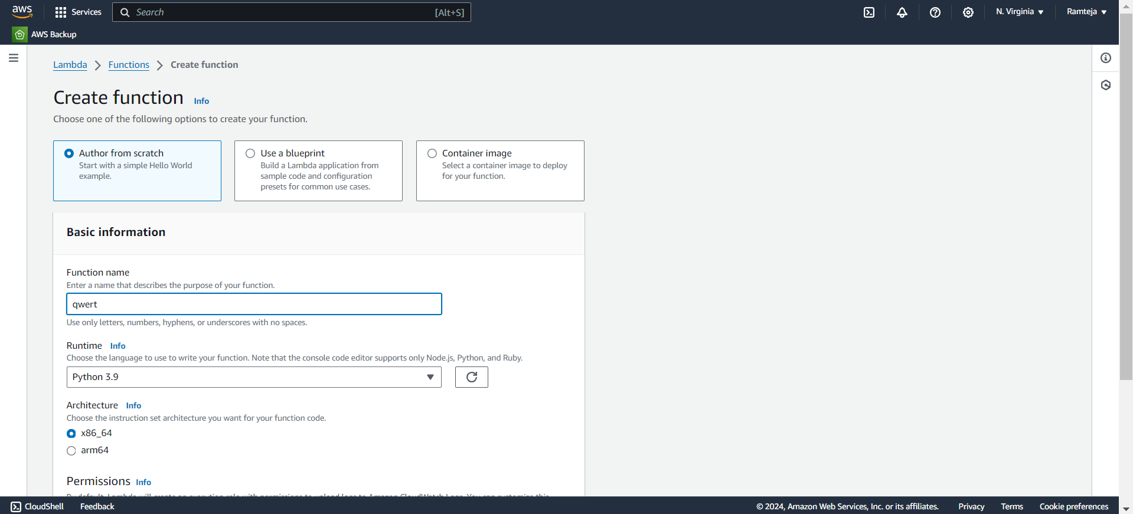
2.2 Assign a Name to Lambda & Runtime.

Slide 10
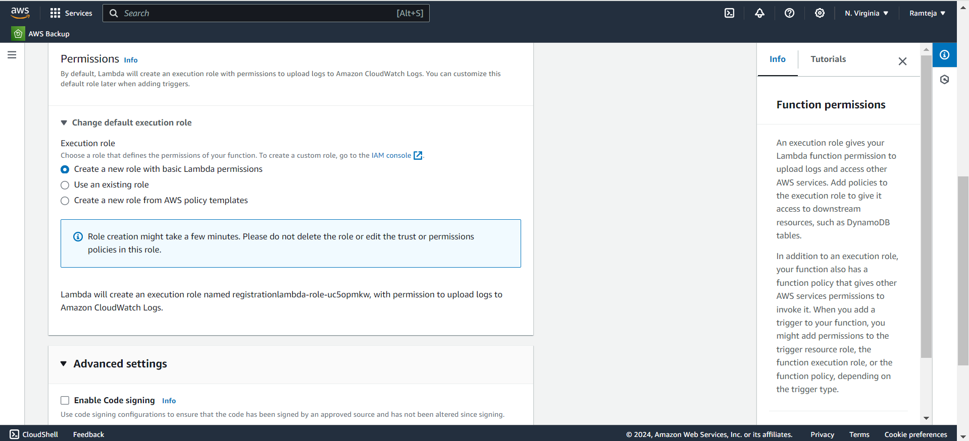
2.3 Follow steps in SettingUpLambda.

Slide 11
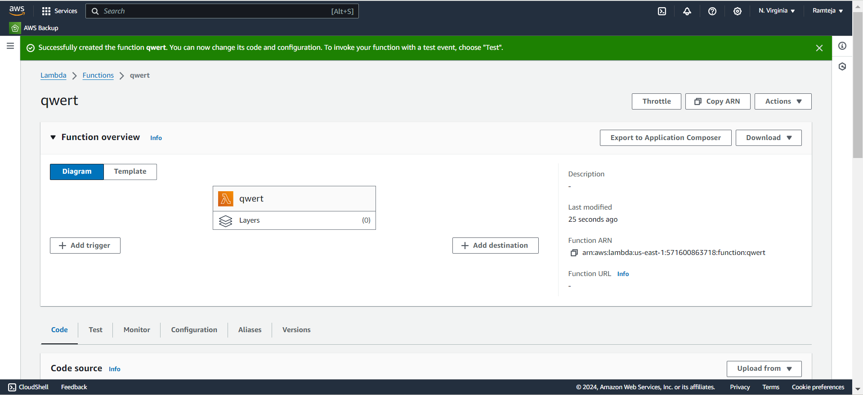
2.4 Lambda is Created & Click on Add trigger.

Slide 12
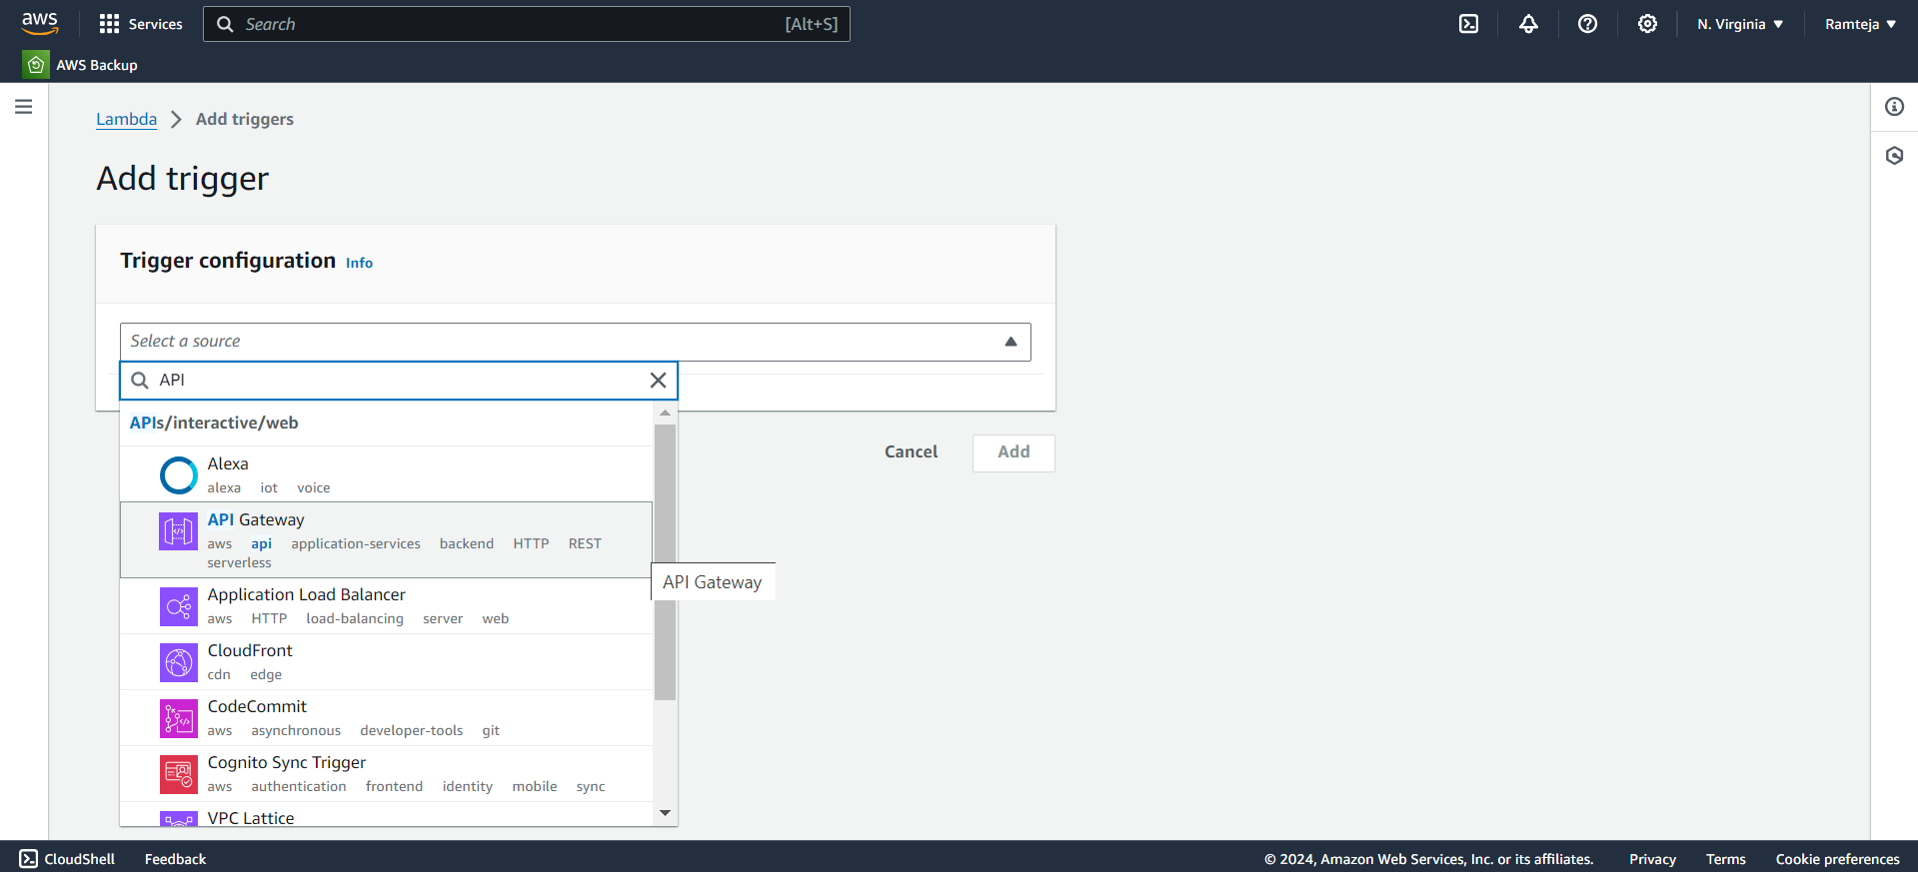
2.5 Search for API Gateway in Trigger Configuration.

Slide 13
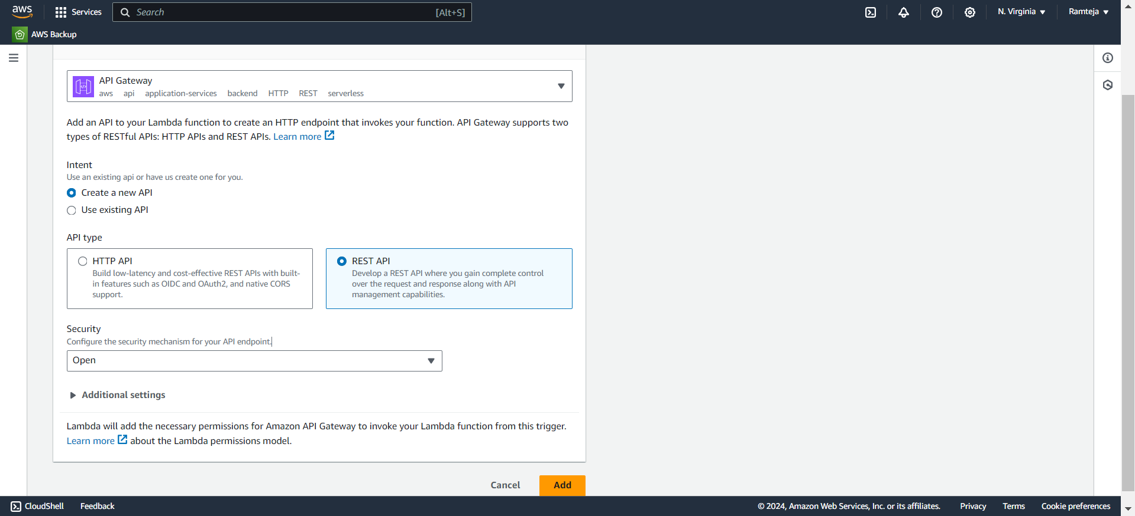
2.6 Follow the steps in SettingUplambda & Click on Add.

Slide 14
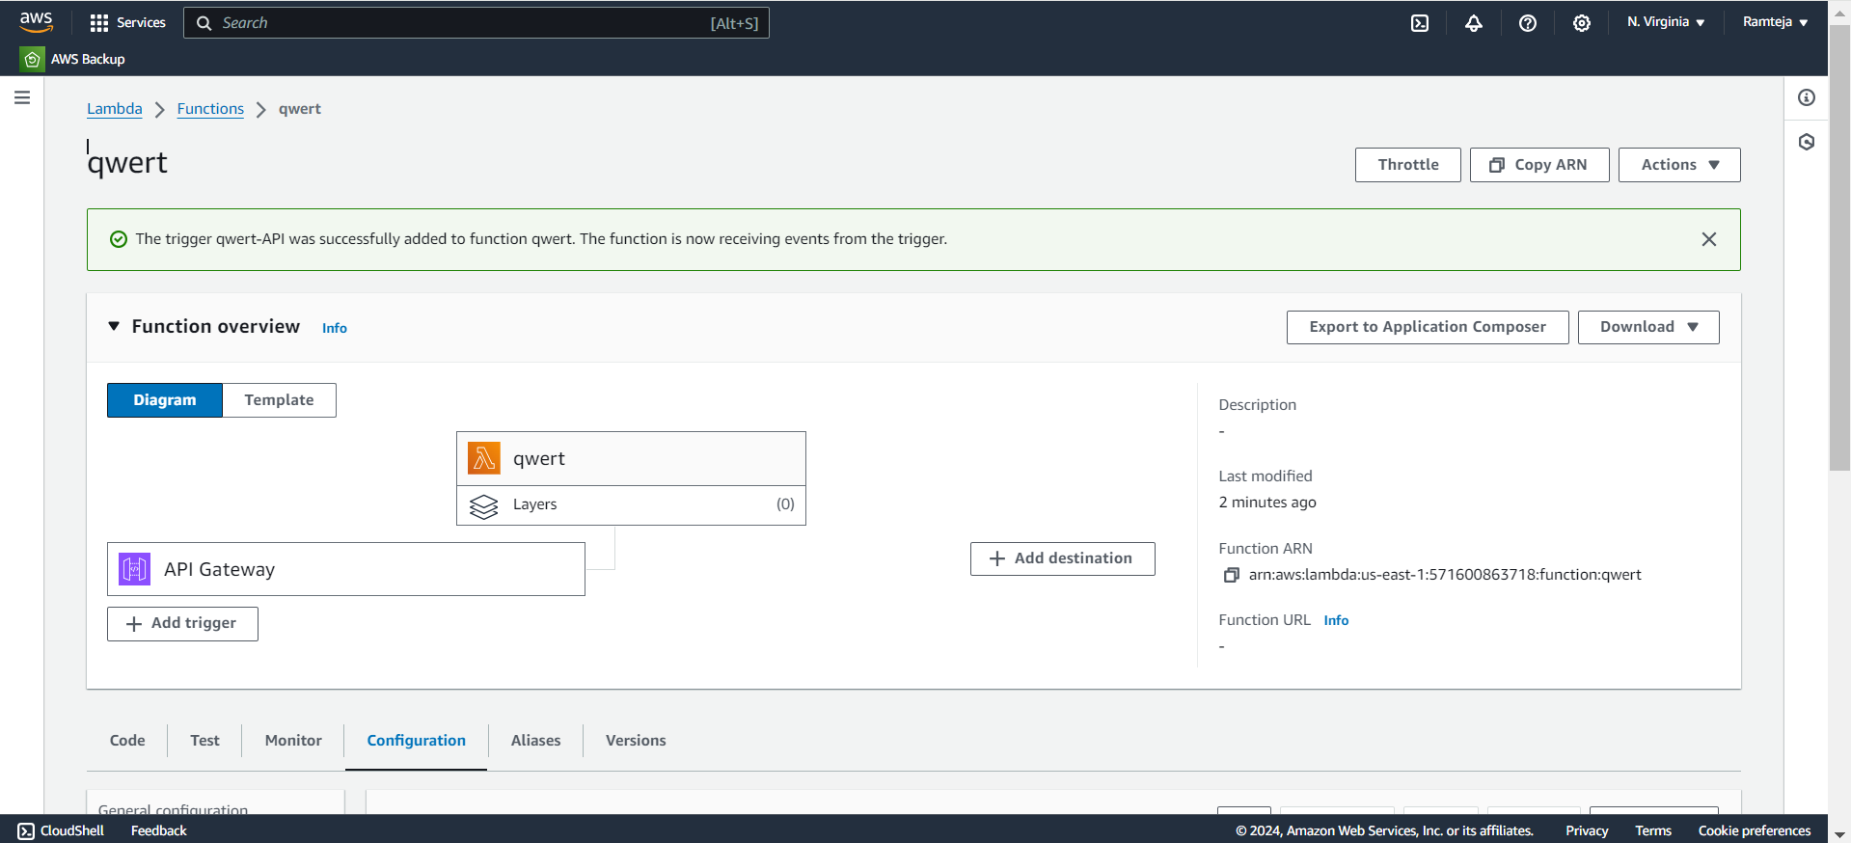
2.7 Trigger API Gateway is added to Lambda.

Slide 15
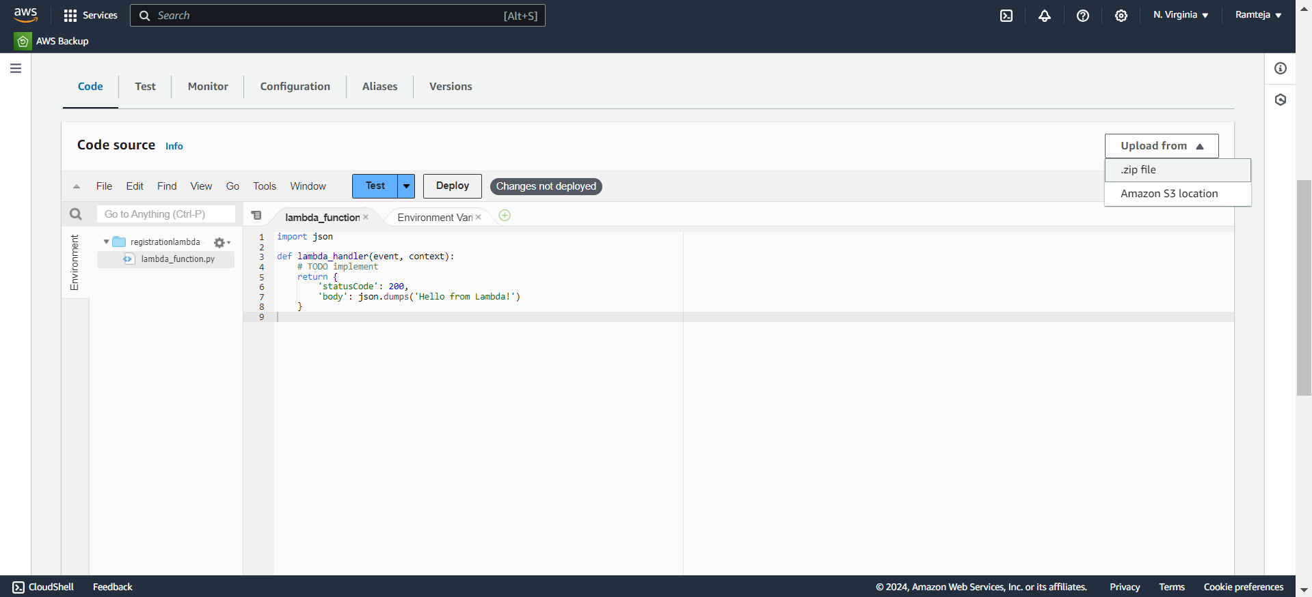
2.8 Click on Code & Click on Upload from.

Slide 16
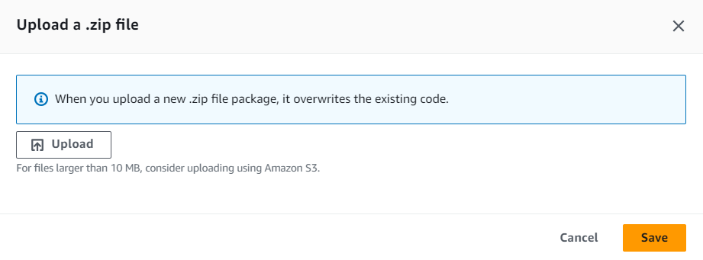
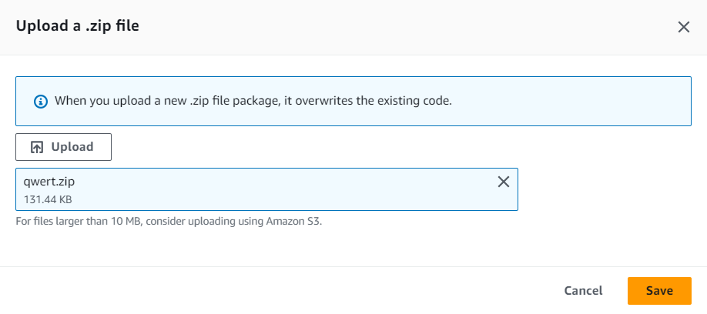
2.9 Select the (Zip)files that has Lamda_function & Upload.

Slide 17
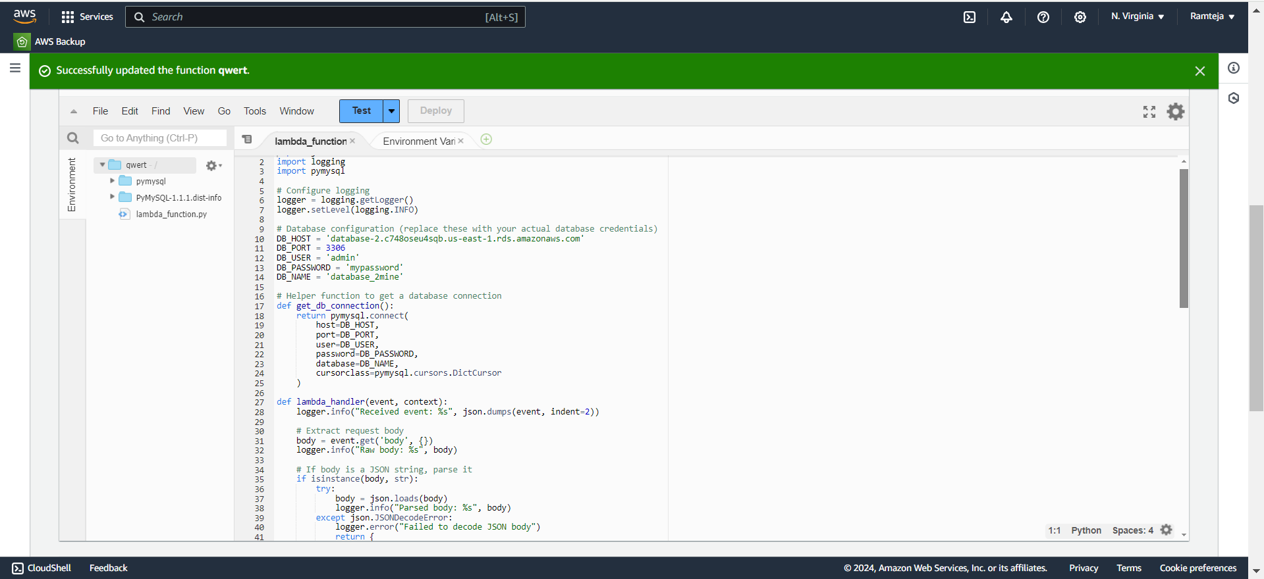
2.10 File Uploaded Successfully.

Slide 18
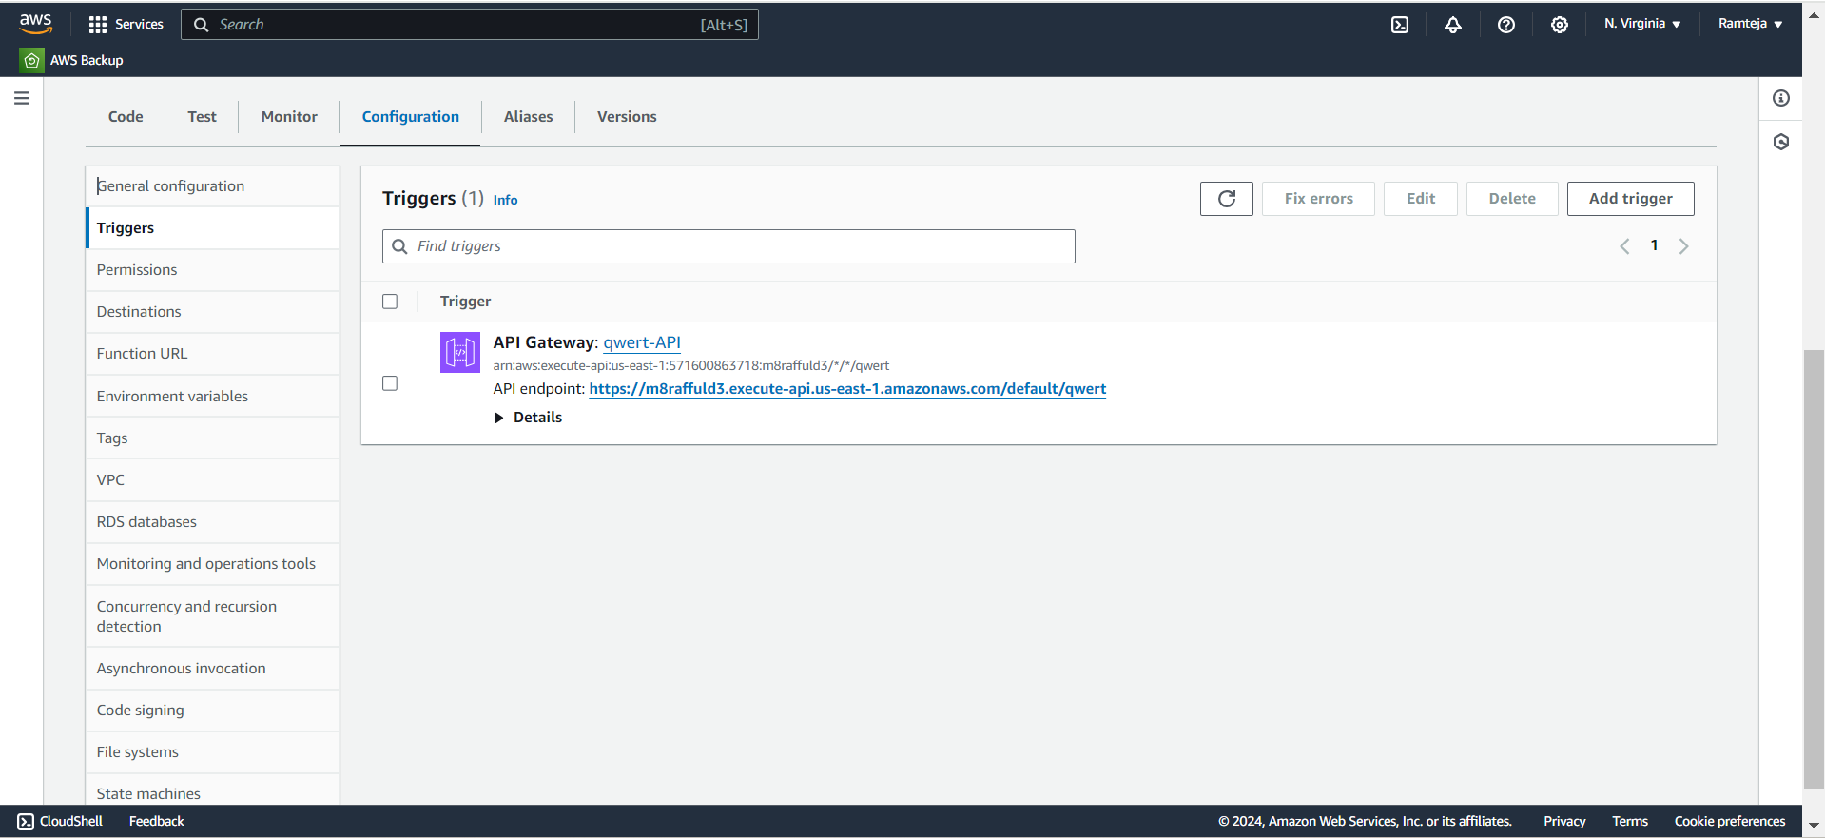
2.11 Click on Configuration in Lambda Function to get API Endpoint.

Slide 19
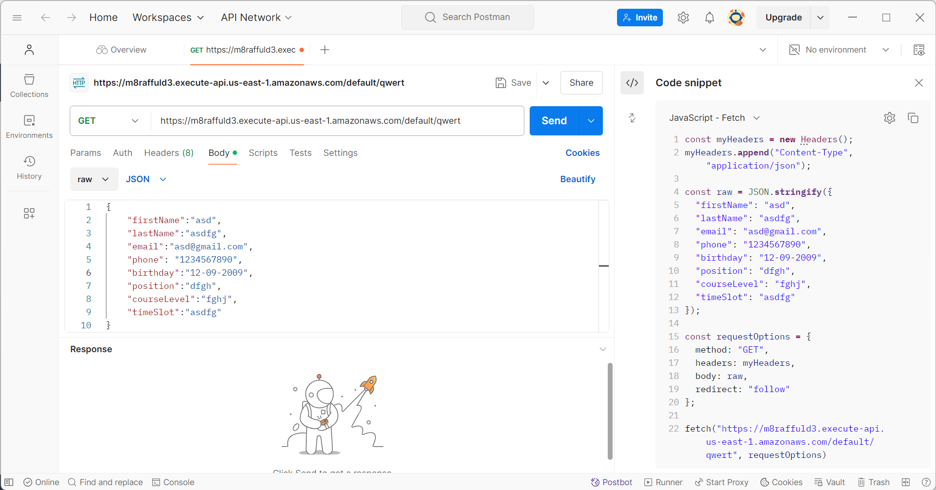
2.12 Copy the API Endpoint IN POSTMAN & Send a Request to Lambda.

Slide 20
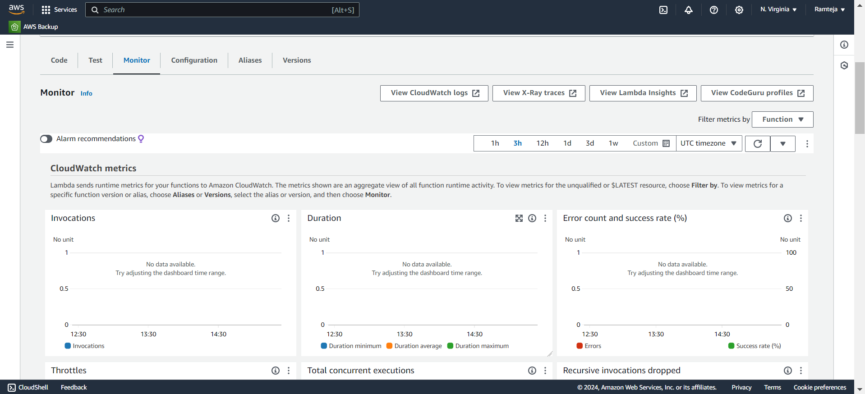
2.13 Click on Monitor in Lambda function & Click on CloudWatch Logs.

Slide 21
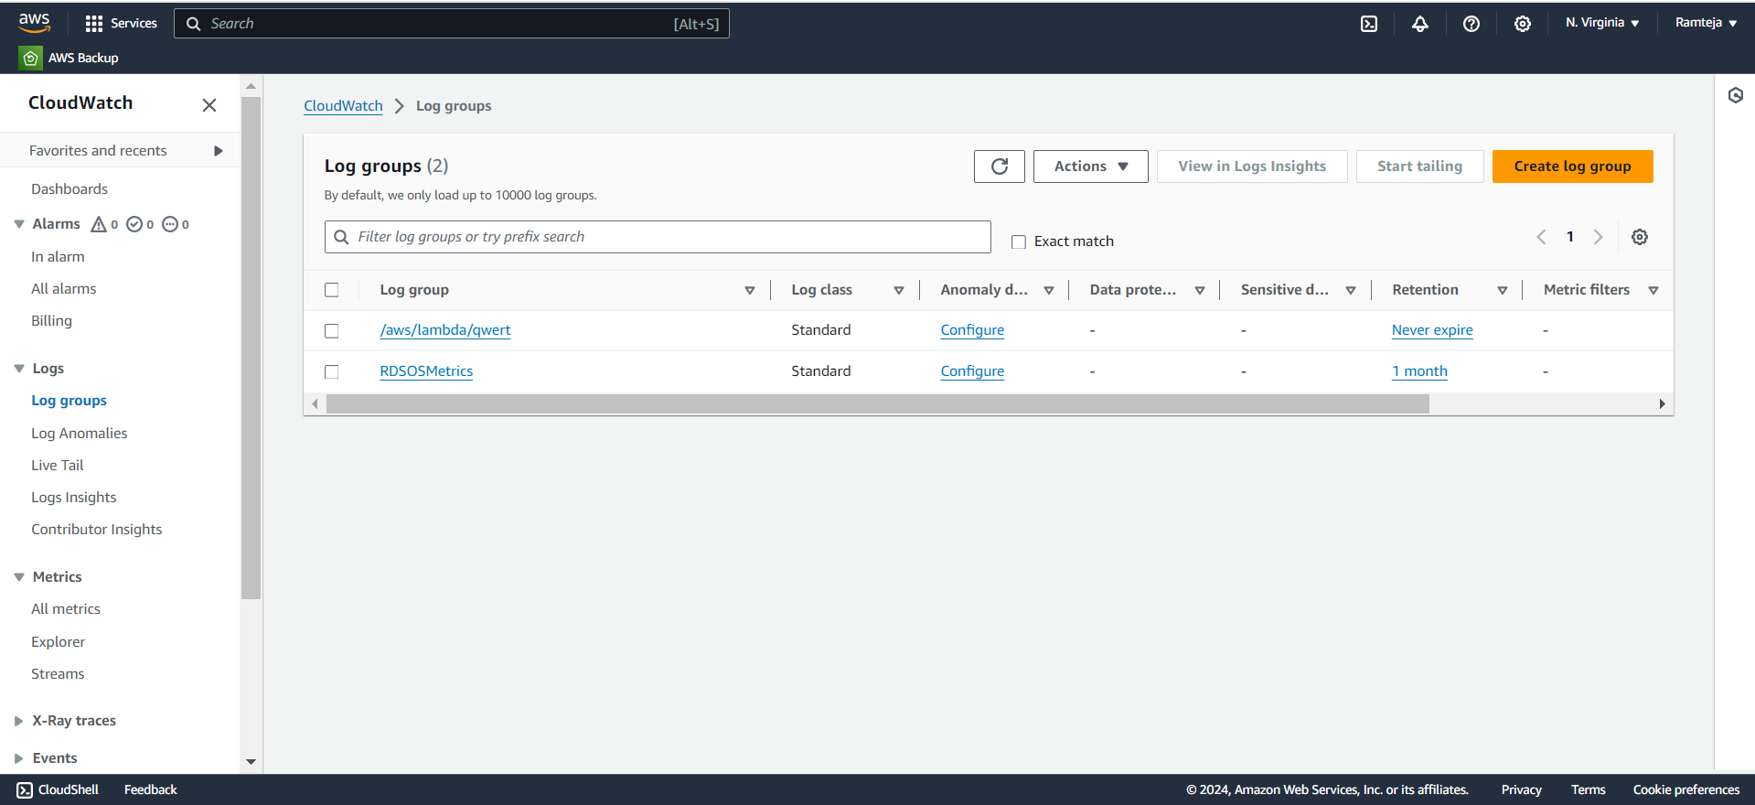
2.14 Open Logs of Lambda function “qwert”.

Slide 22
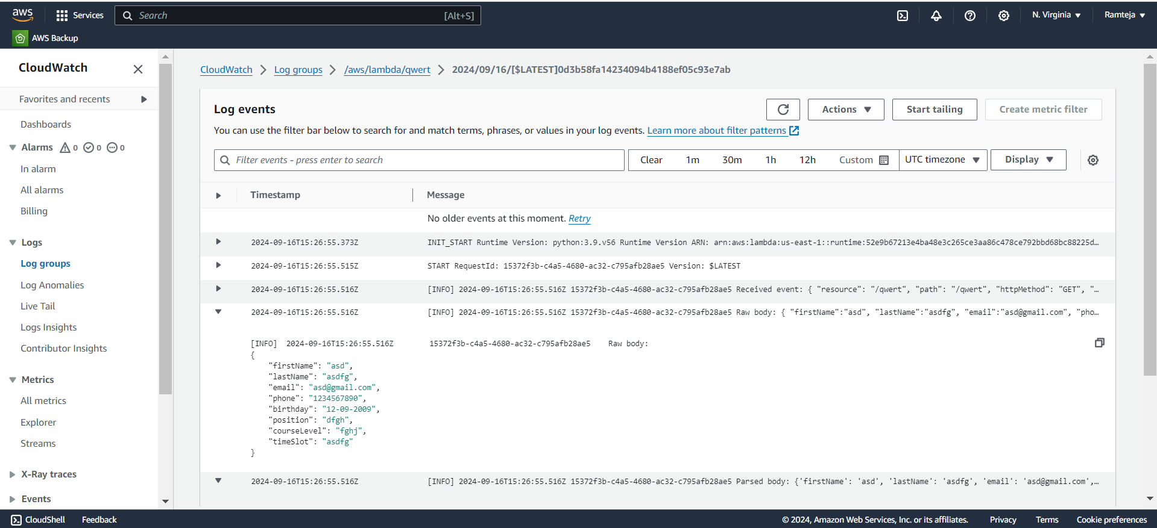
2.15 The log of Hitting Request to Lambda via API Gateway from Postman.

Slide 23
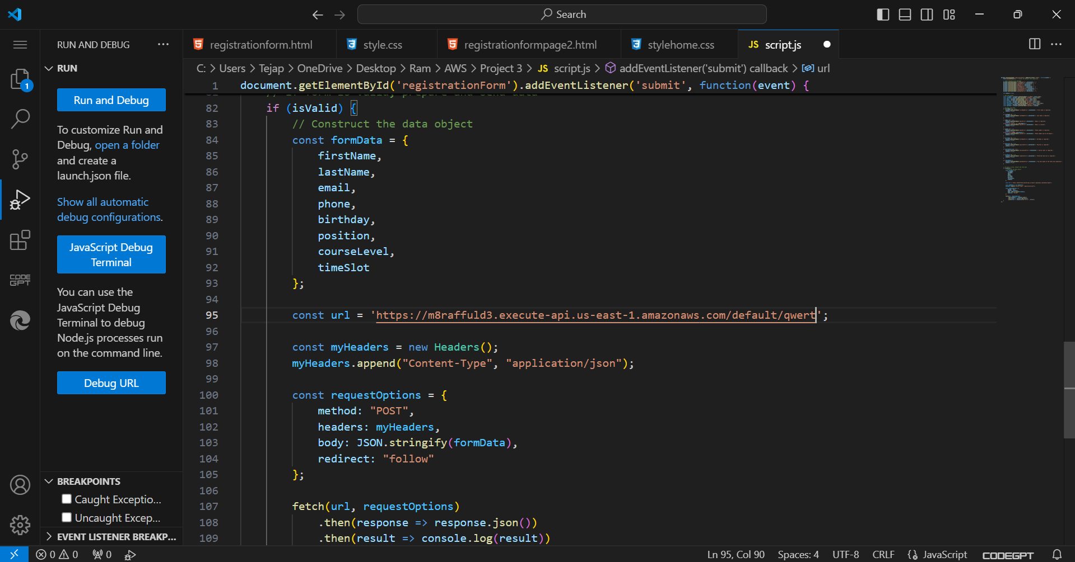
2.16 Copy the API Endpoint in JavaScript code of website.

Slide 24
3.Setting up S3 bucket
1.Search for S3 in Search bar and open S3 dashboard, Click on Create Bucket.
2.Select the bucket type as General Purpose, Give Unique bucket name to your bucket.
3.Checkmark on Block All public Access, Select ACL’s disable in Object Ownership & Create on Bucket.
4. Select the S3 Bucket ,Click on Objects ,Click on Upload & Choose the files from your PC.
5.Click on file to be uploaded (Html css js) and Click on Upload.
6.When we use the Object URL of this file in S3 bucket it will be only available for your Private users.
7.If the Public Users wants to access the website.
8.Select the file in S3 bucket ,Click on permissions, Uncheck mark the “Block all public access” to convert into Public ,Copy the Bucket ARN number & Click on Edit on Bucket Policy.

Slide 25
9.Select S3 bucket policy in Select Policy type ,Click on Allow Effects & Type * in Principles.
10.Check mark All Actions , Paste the Bucket ARN and enter /* after Bucket ARN.
11.Click On Add Statement & Click on Generate Policy.
12.Copy the code from AWS Policy and Paste it in Bucket Policy & Save it.
13.Bucket Policy edited Successfully.
14. Now public users can access our website by Object URL.

Slide 26
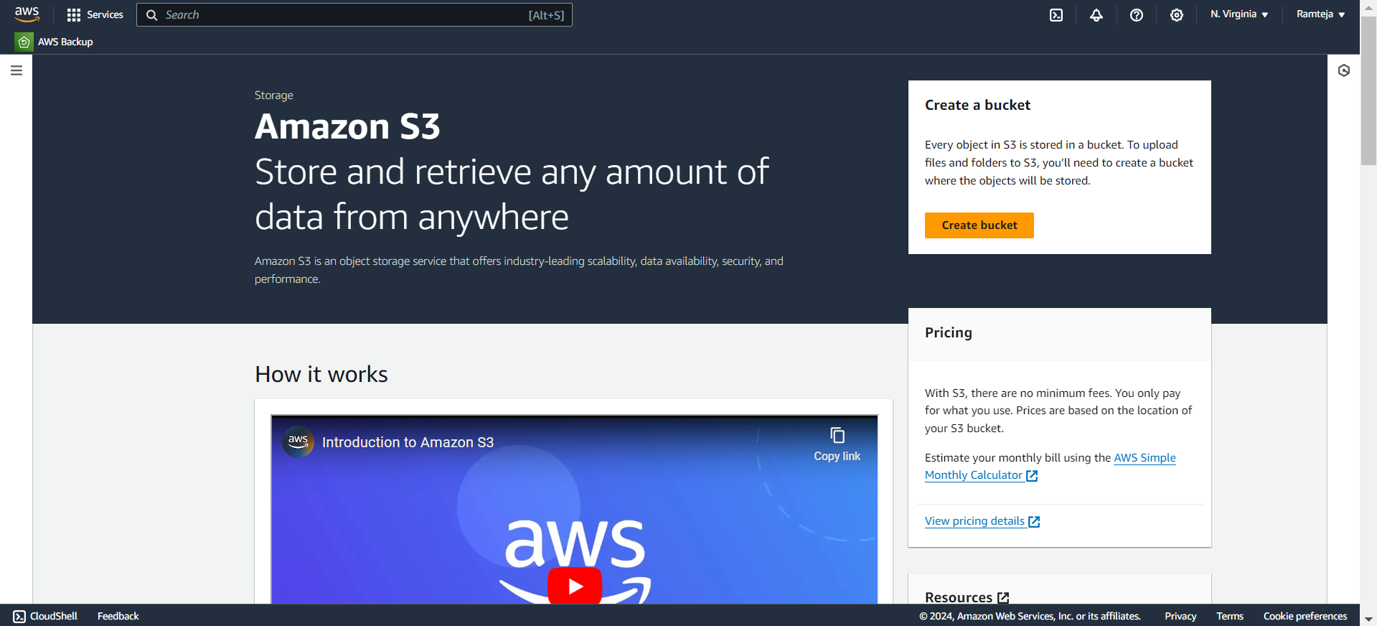
3.1 Click On Create Bucket.

Slide 27
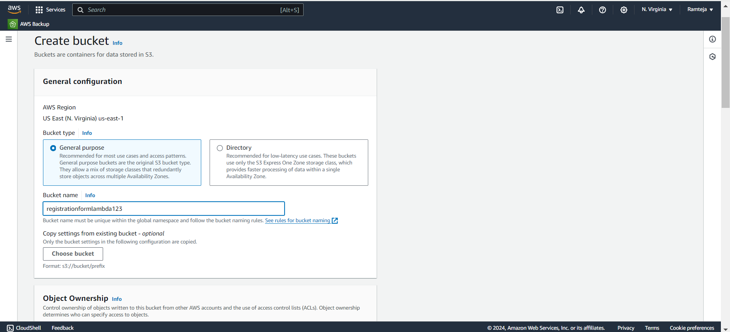
3.2 Give Unique Name for your Bucket.

Slide 28
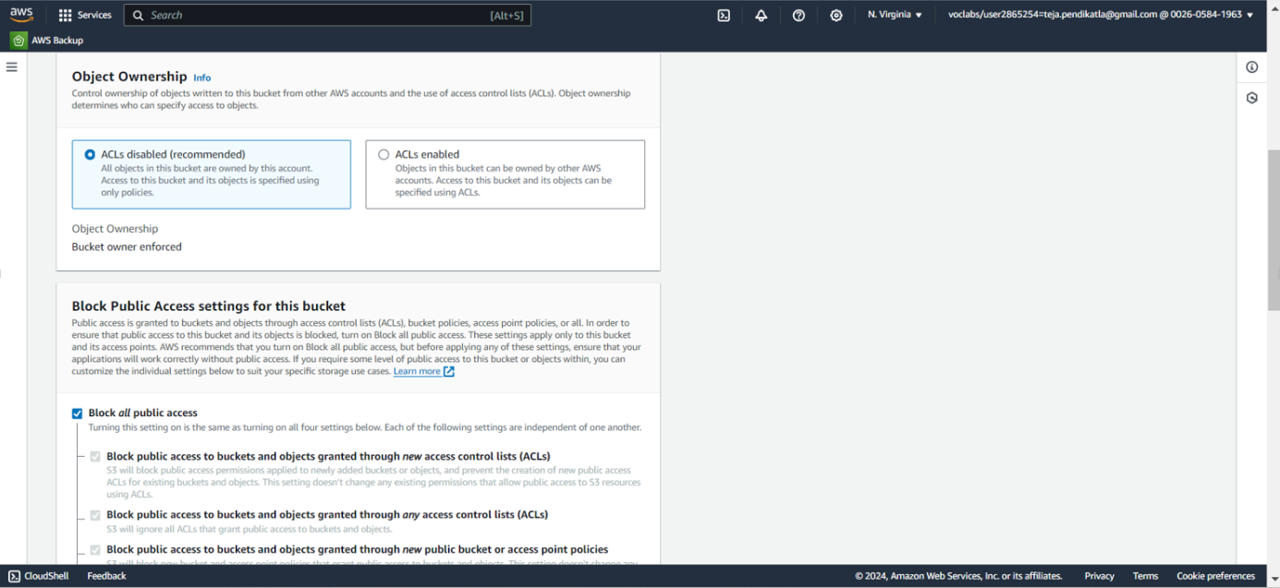
3.3 Follow the steps in Setting Up S3.

Slide 29
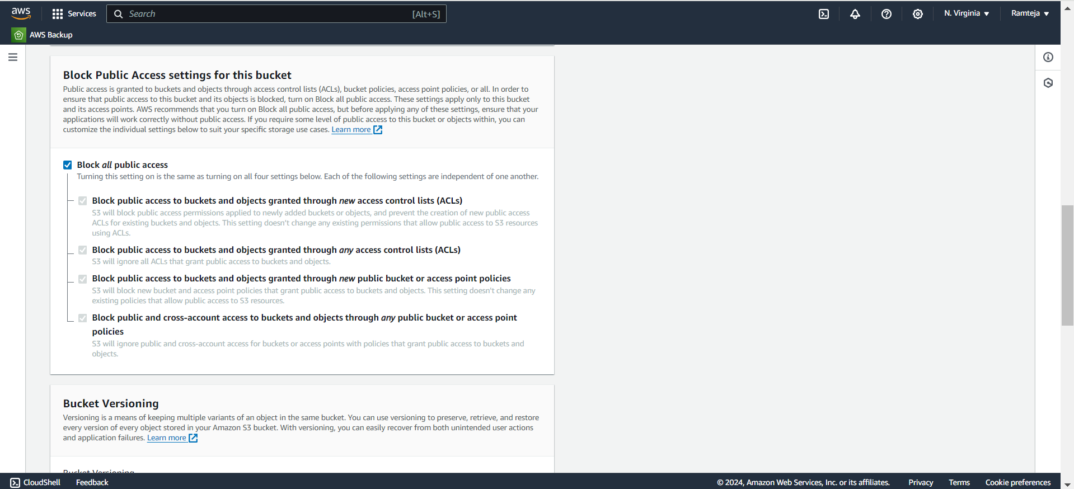
3.4 Make Sure that the Checkmark is ticked in Block all public access.

Slide 30
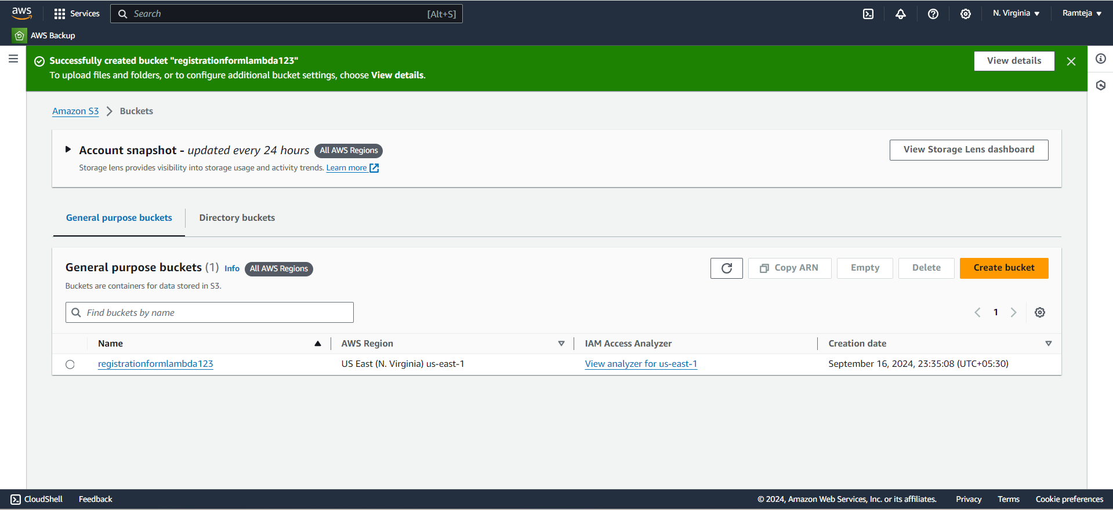
3.5 Bucket Created Successfully & Open the bucket.

Slide 31
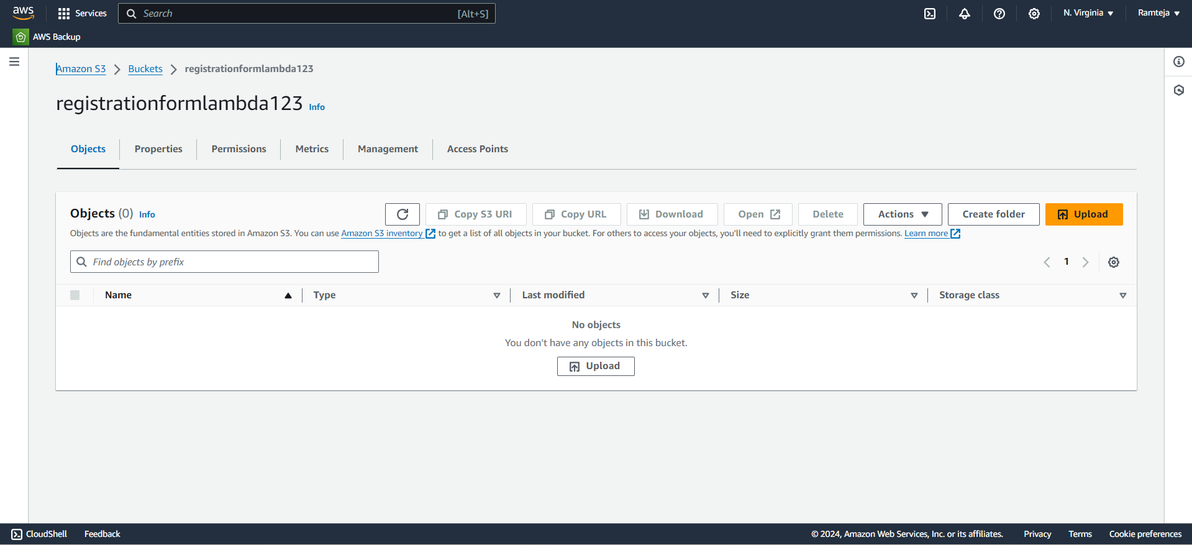
3.6 Click on Upload to add files in bucket.

Slide 32
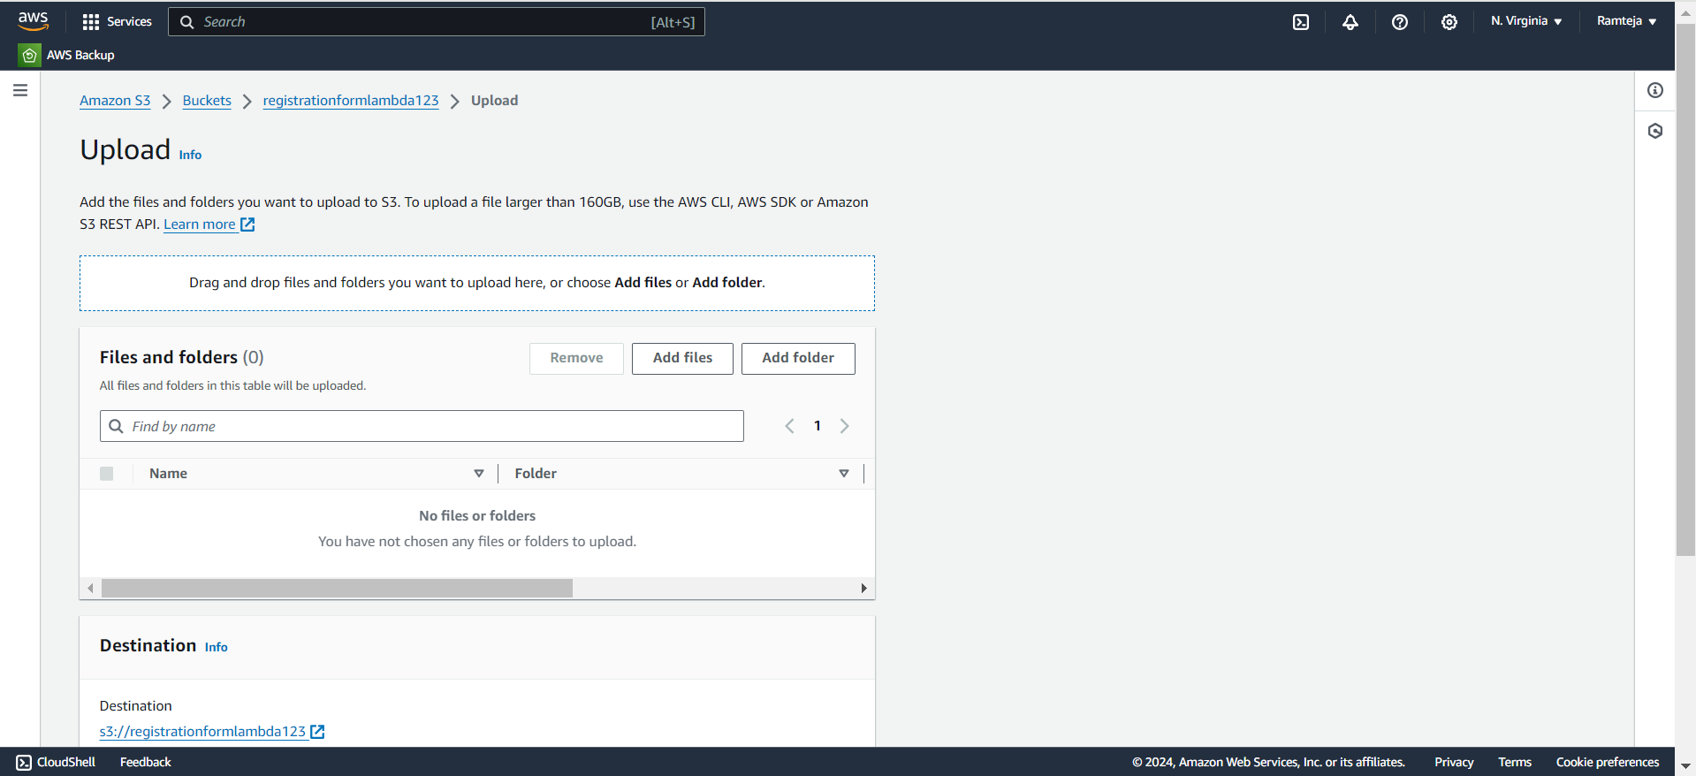
3.7 Click on Add files.

Slide 33
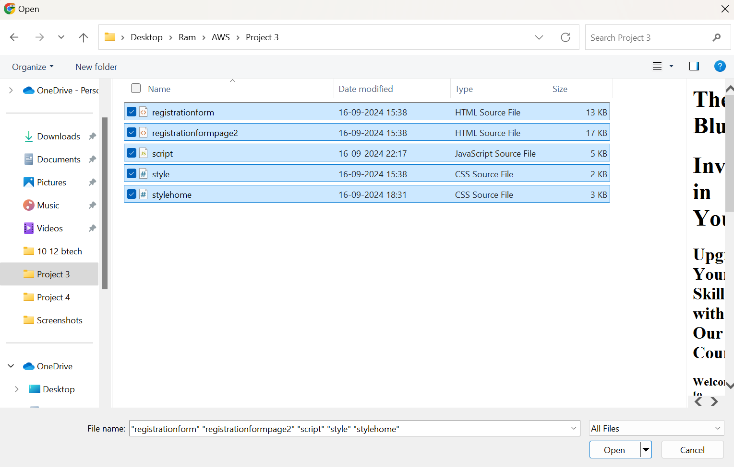
3.8 Select the files from the PC.

Slide 34
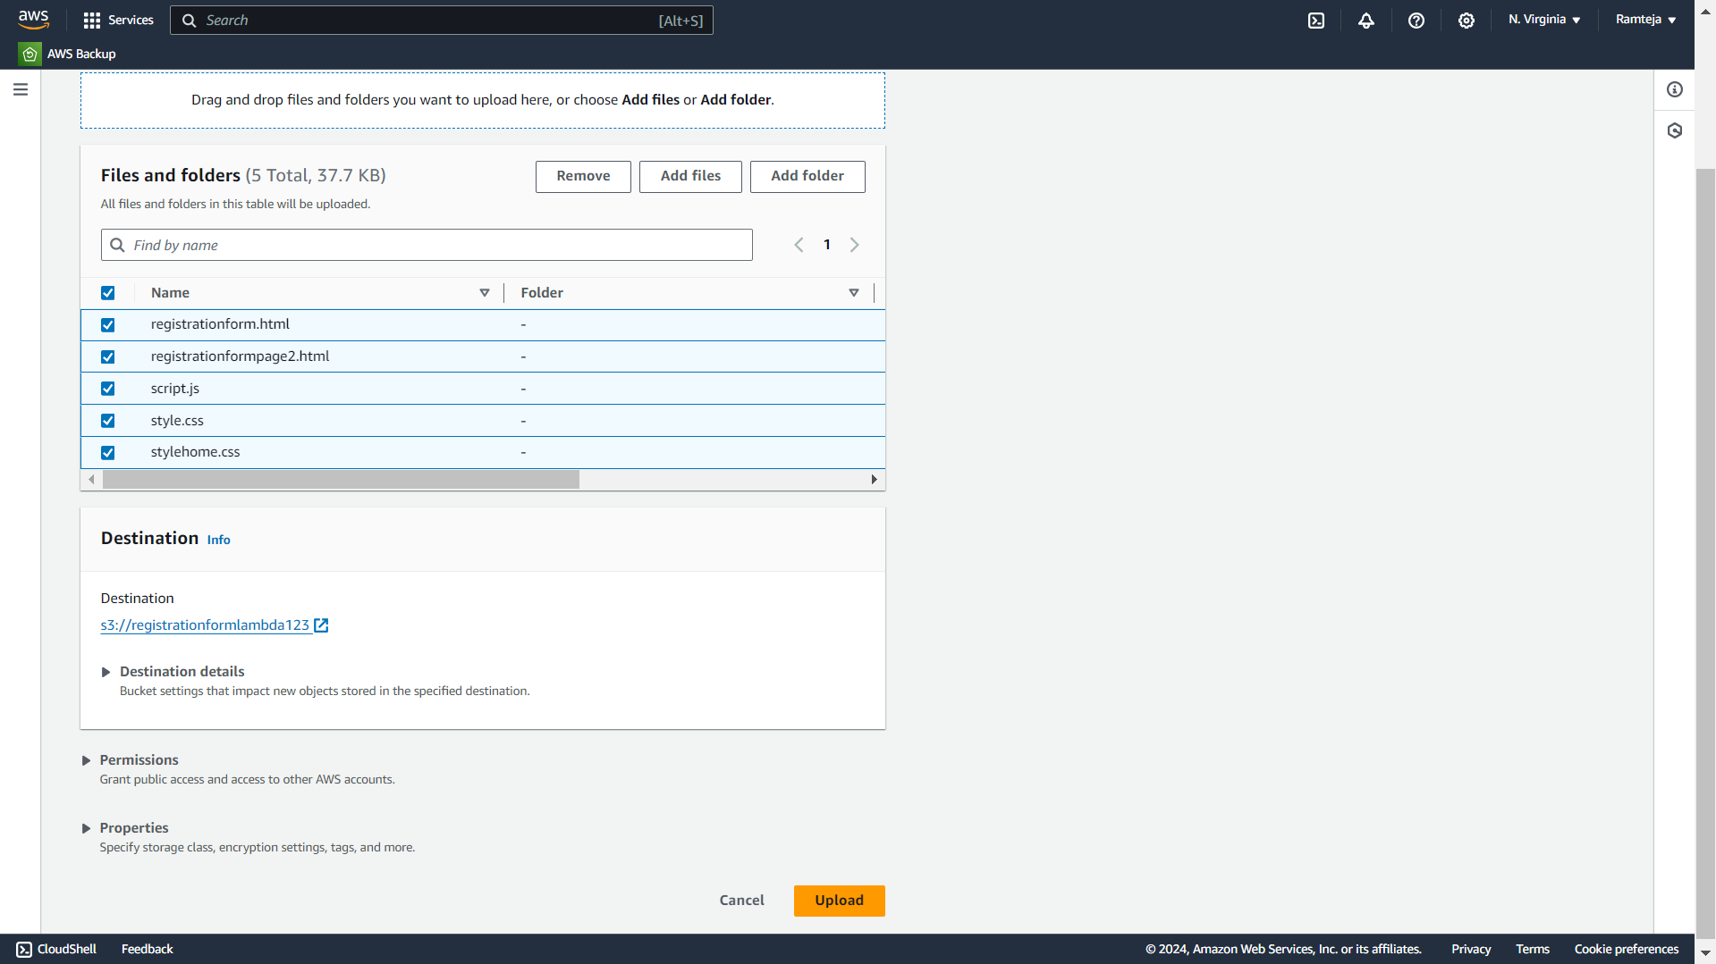
3.9 Select all Files & Click Upload.

Slide 35
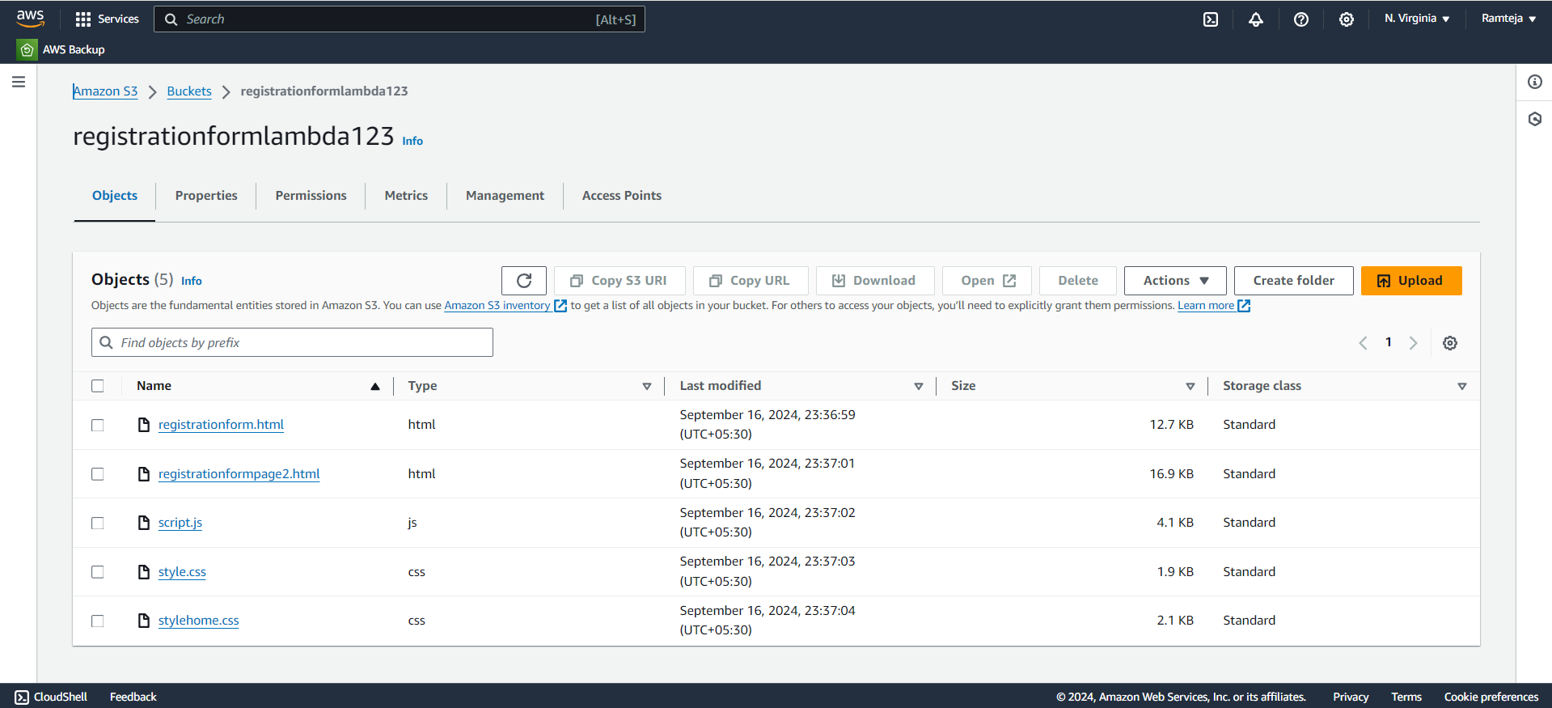
3.10 Objects in S3 bucket added Successfully.

Slide 36
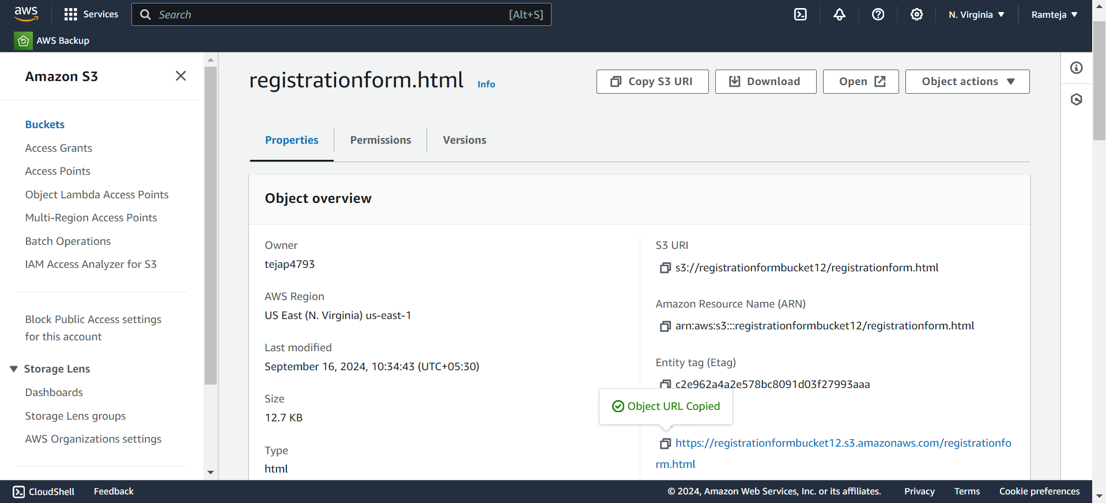
3.11 Copy the Object-URL of registrationform.html

Slide 37
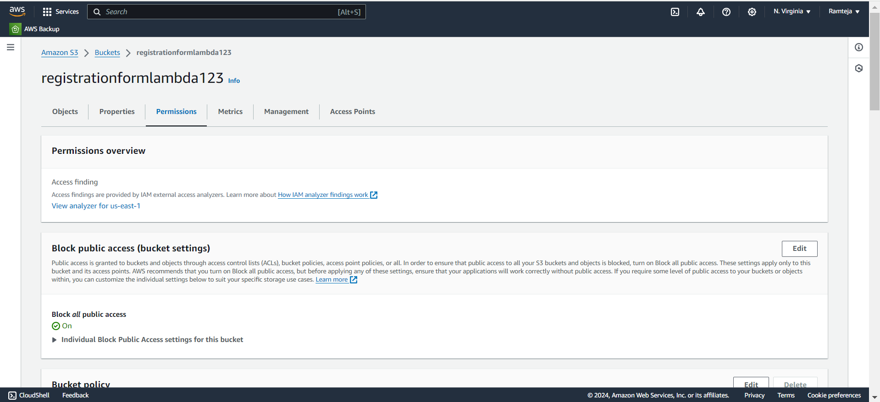
3.12 Click on Edit in Block Public Access.

Slide 38
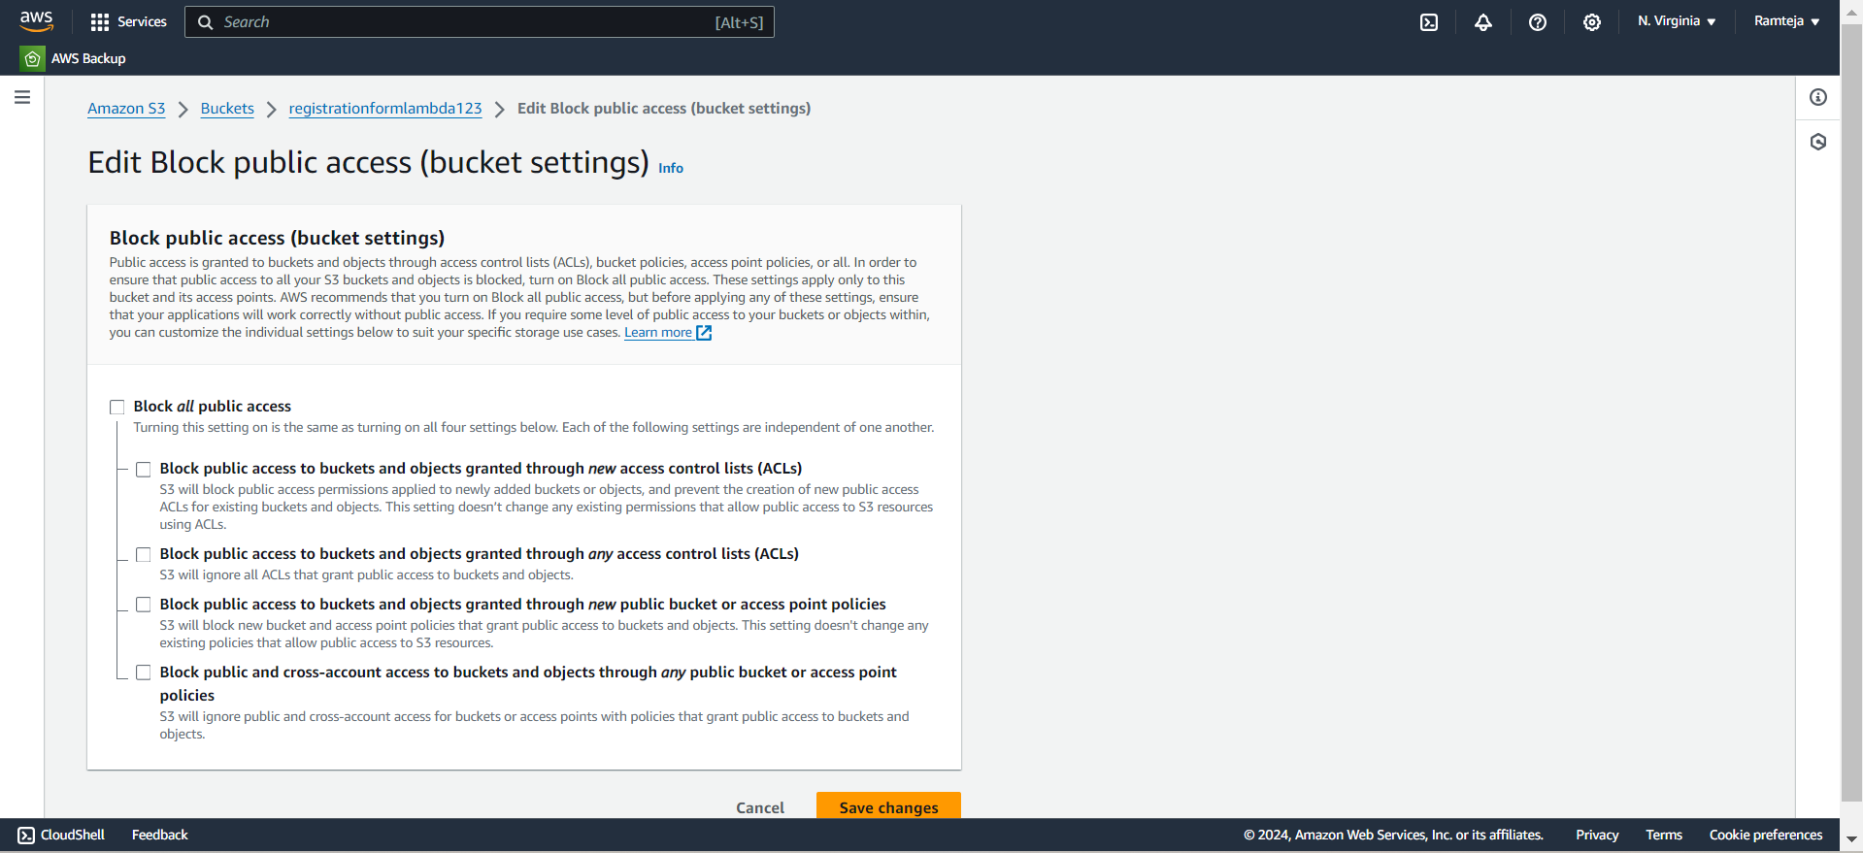
3.13 Uncheck the Block all public access.

Slide 39
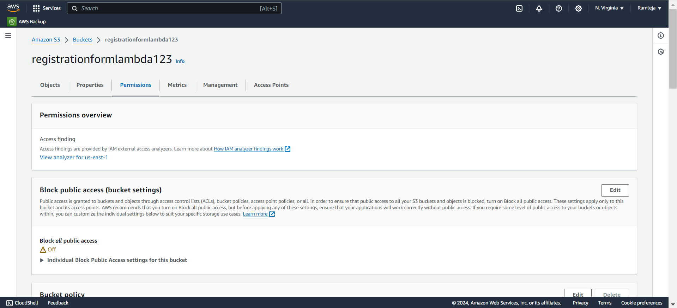
3.14 Now the bucket is Public.

Slide 40
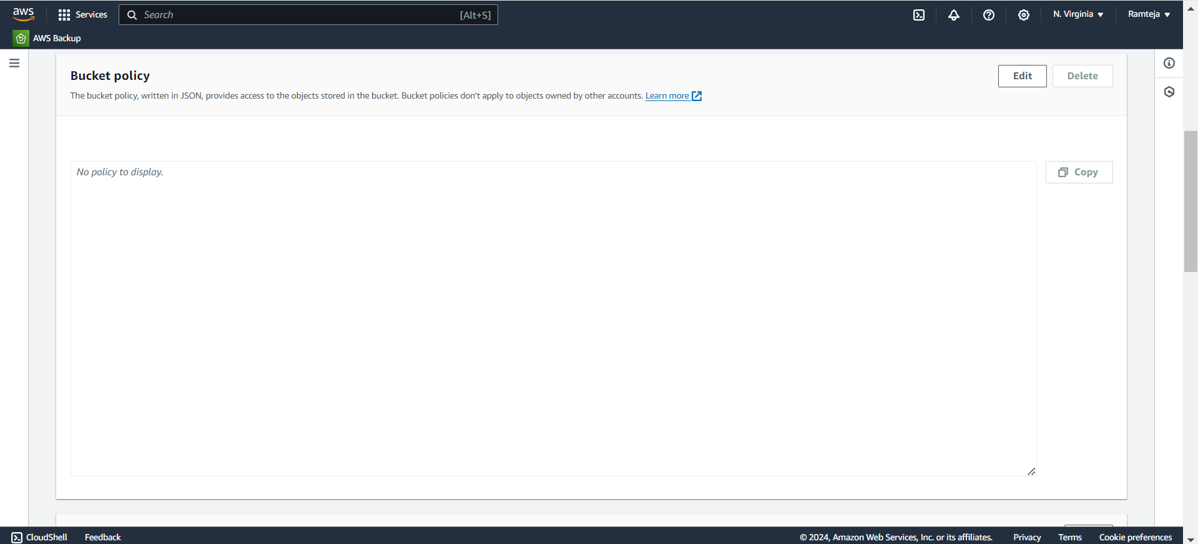
3.15 Click on Edit in Bucket Policy.

Slide 41
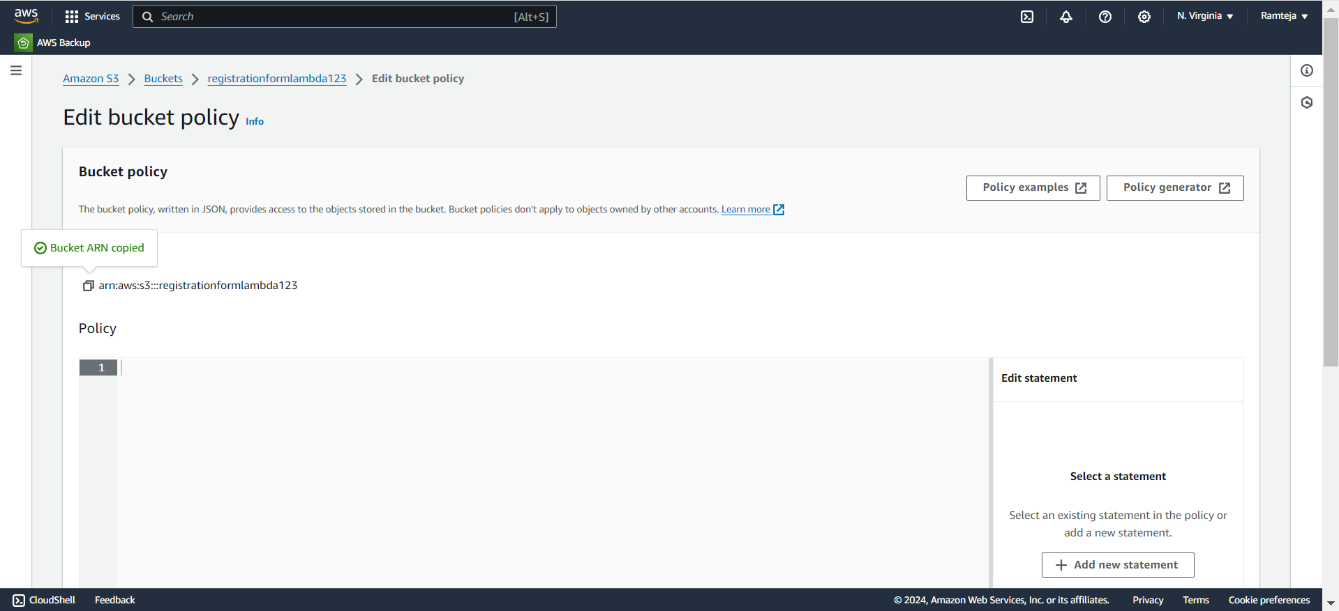
3.16 Copy the Bucket ARN & Click on Policy Generator.

Slide 42
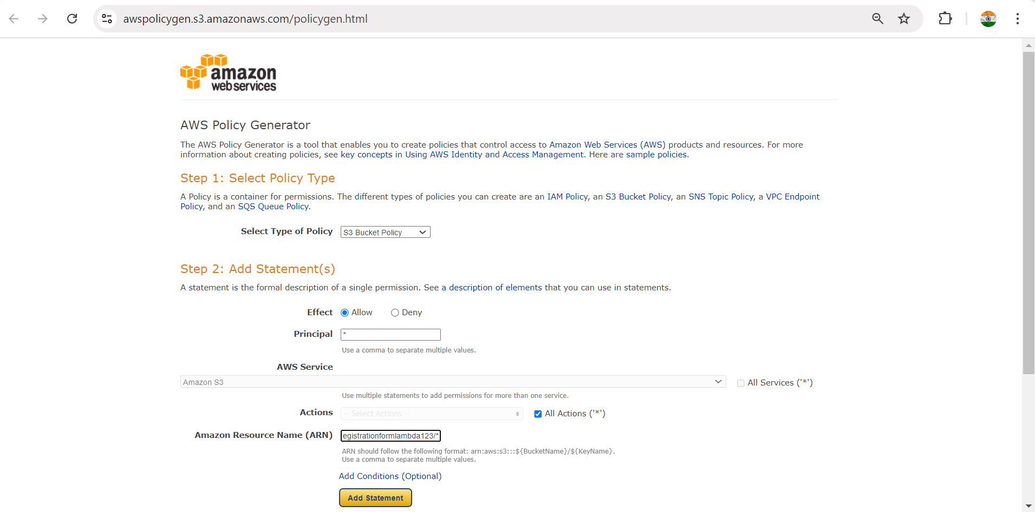
3.17 Create a New Policy Generator.

Slide 43
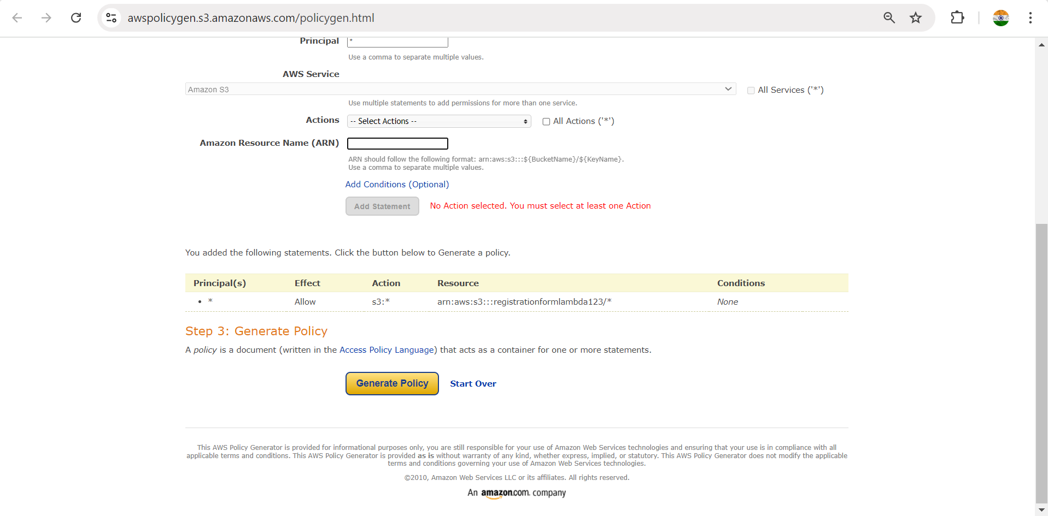
3.18 Follow the steps in SettingUp S3.

Slide 44
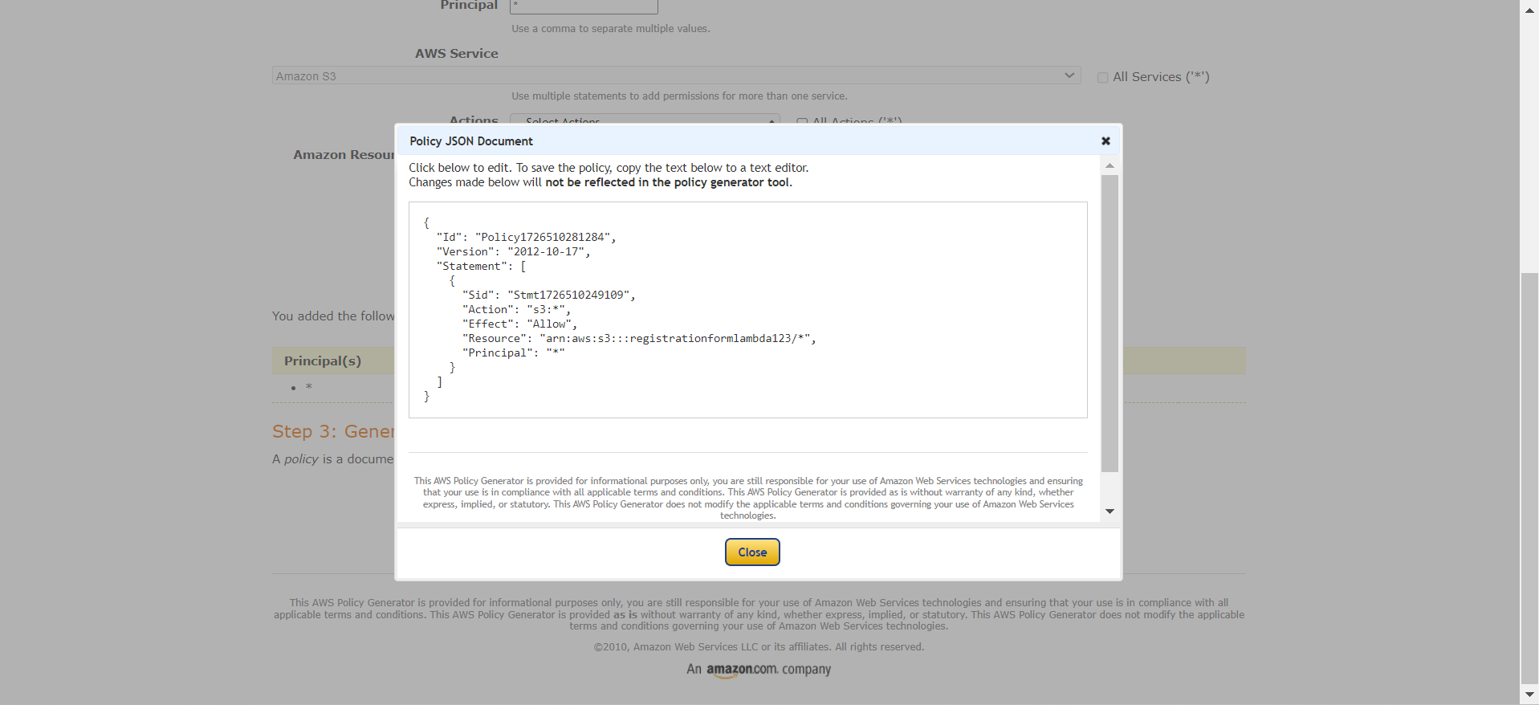
3.19 Click on Generate Policy & Copy the code.

Slide 45
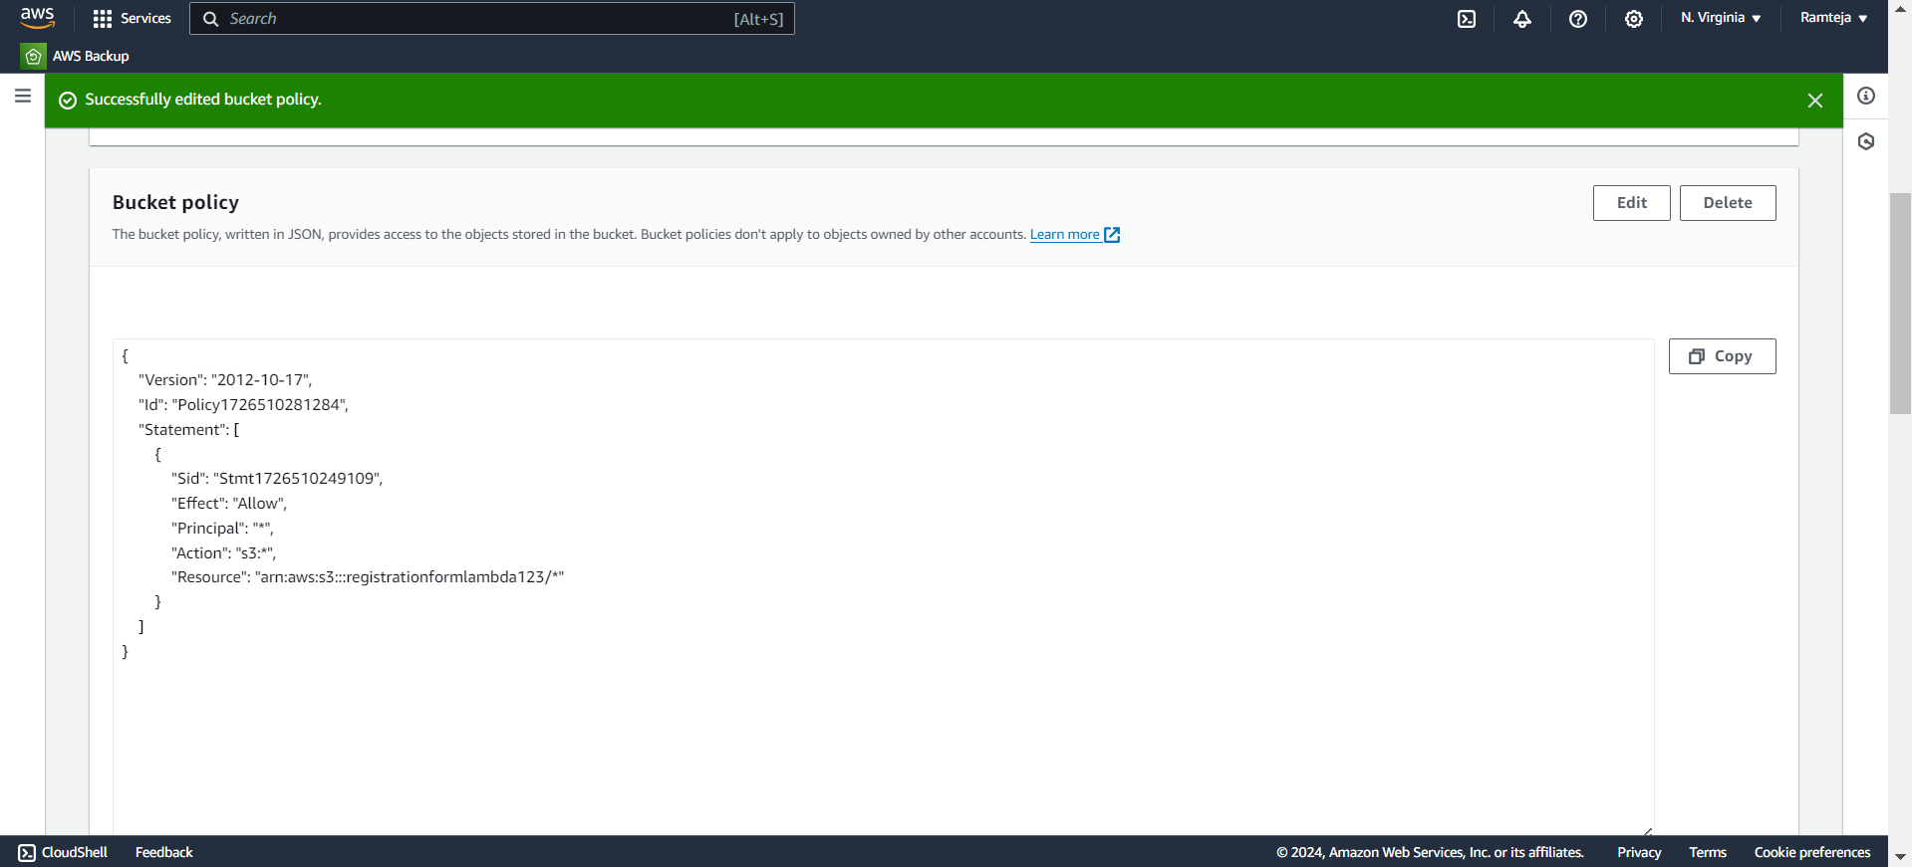
3.20 Paste the Code here & Click on Save.

Slide 46
3.21 Copy the Object URL of registrationform.html to share everyone.

Slide 47
4.Setting Up RDS
1.Search for RDS in Search bar and open RDS dashboard, Click on Dashboard.
2.Click on Create Dashboard ,Select Standard Create in choose Database Creation Method & Select Engine of database.
3.Select Free Tier in Templates , Give Name to database, Create Username & Create Master Password for database in Credential Settings.
4.Select the Instance type, Storage & Select default VPC ,Checkmark Yes in Public Access.
5.Select default Security Group & Choose Availability Zone.
6.Enable Enhance Monitoring In Monitoring & Click on Create.
7.Database is created , Open database , Click on Connectivity & Security.
8.Click on VPC Security groups, Click on default group ,it will direct us to Security group details.
9.Click on Inbound rules , Click on edit Inbound rules & Click add rules – Select Custom TCP with port number 3306(Database port number) & Click on save.
10.Copy the Endpoint of the Database.

Slide 48
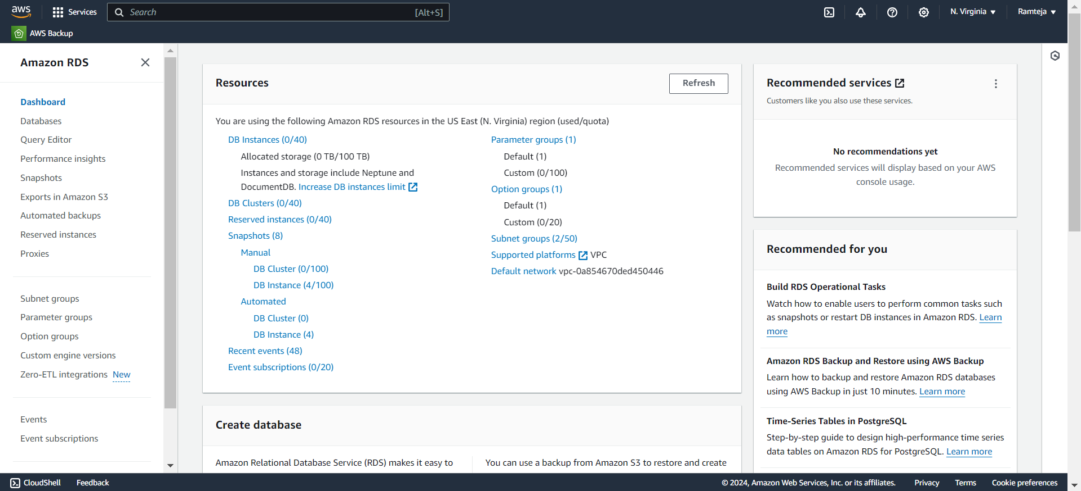
4.1 Click on Dashboards in RDS Dashboard.

Slide 49
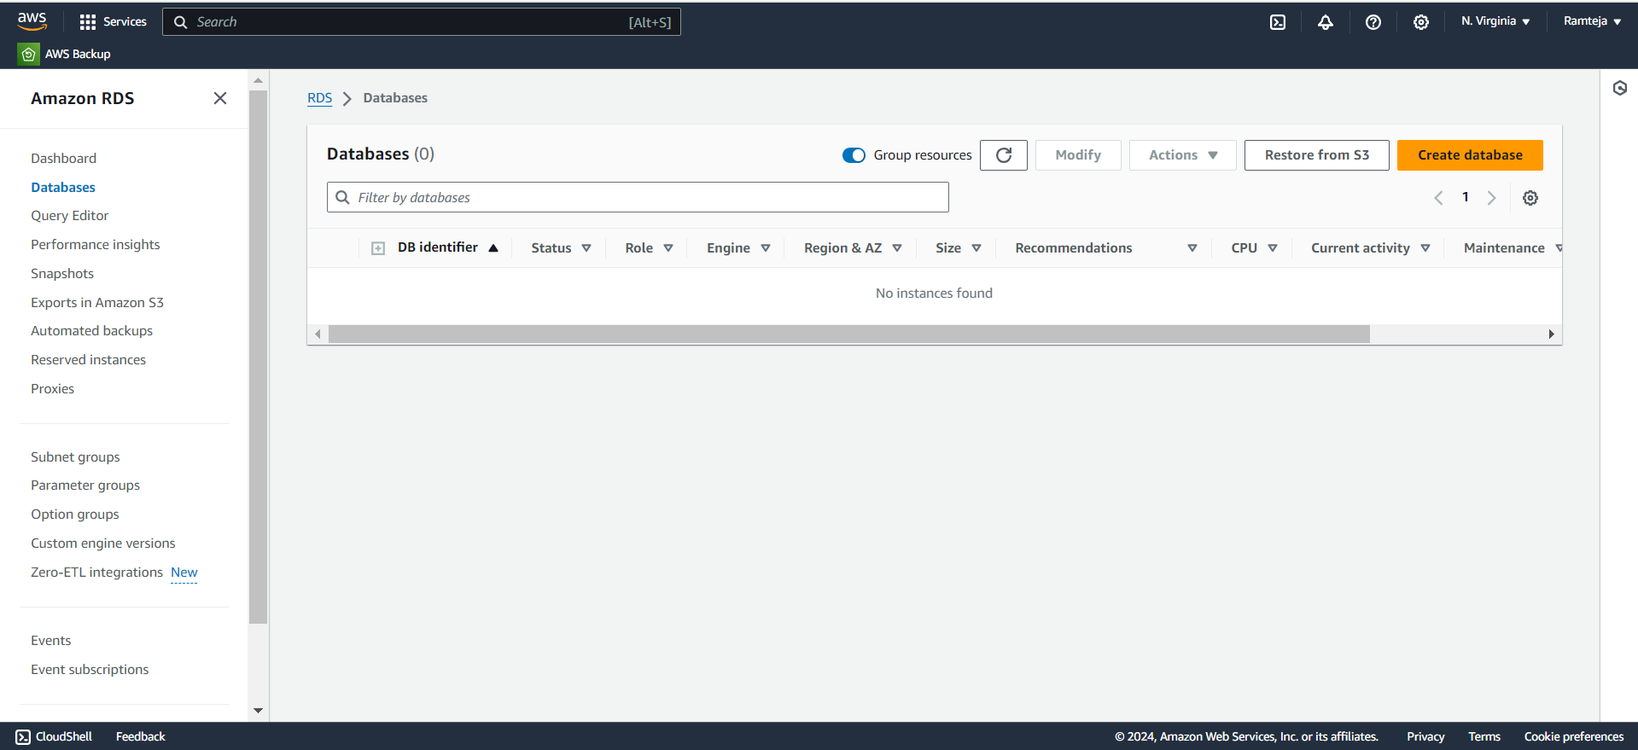
4.2 Click on Create Databases.

Slide 50
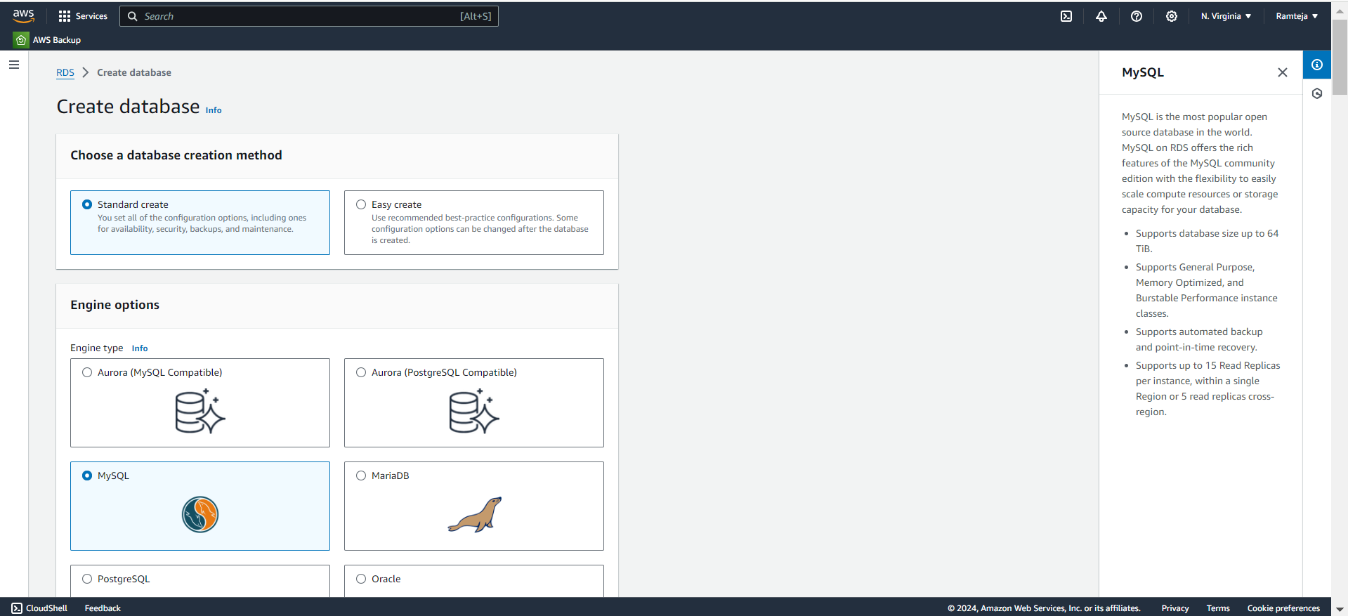
4.3 Select Standard Create & Engine of database.

Slide 51
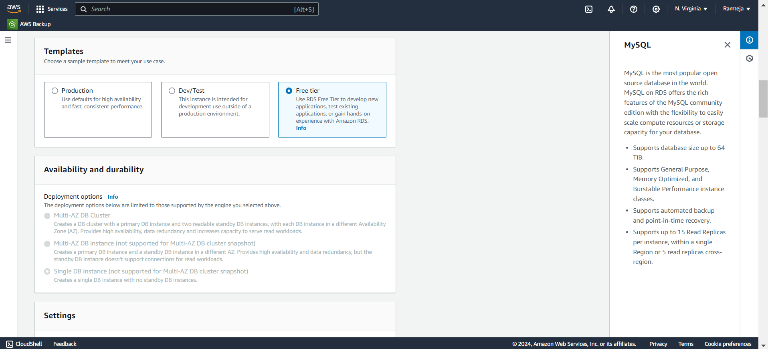
4.4 Select Free Tier in Templates.

Slide 52
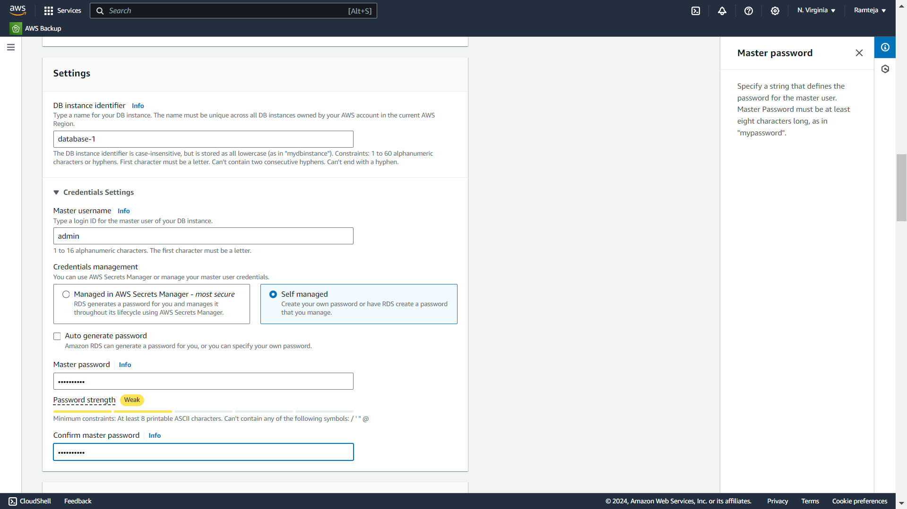
4.5 Give Name , Username & Create Password for database.

Slide 53
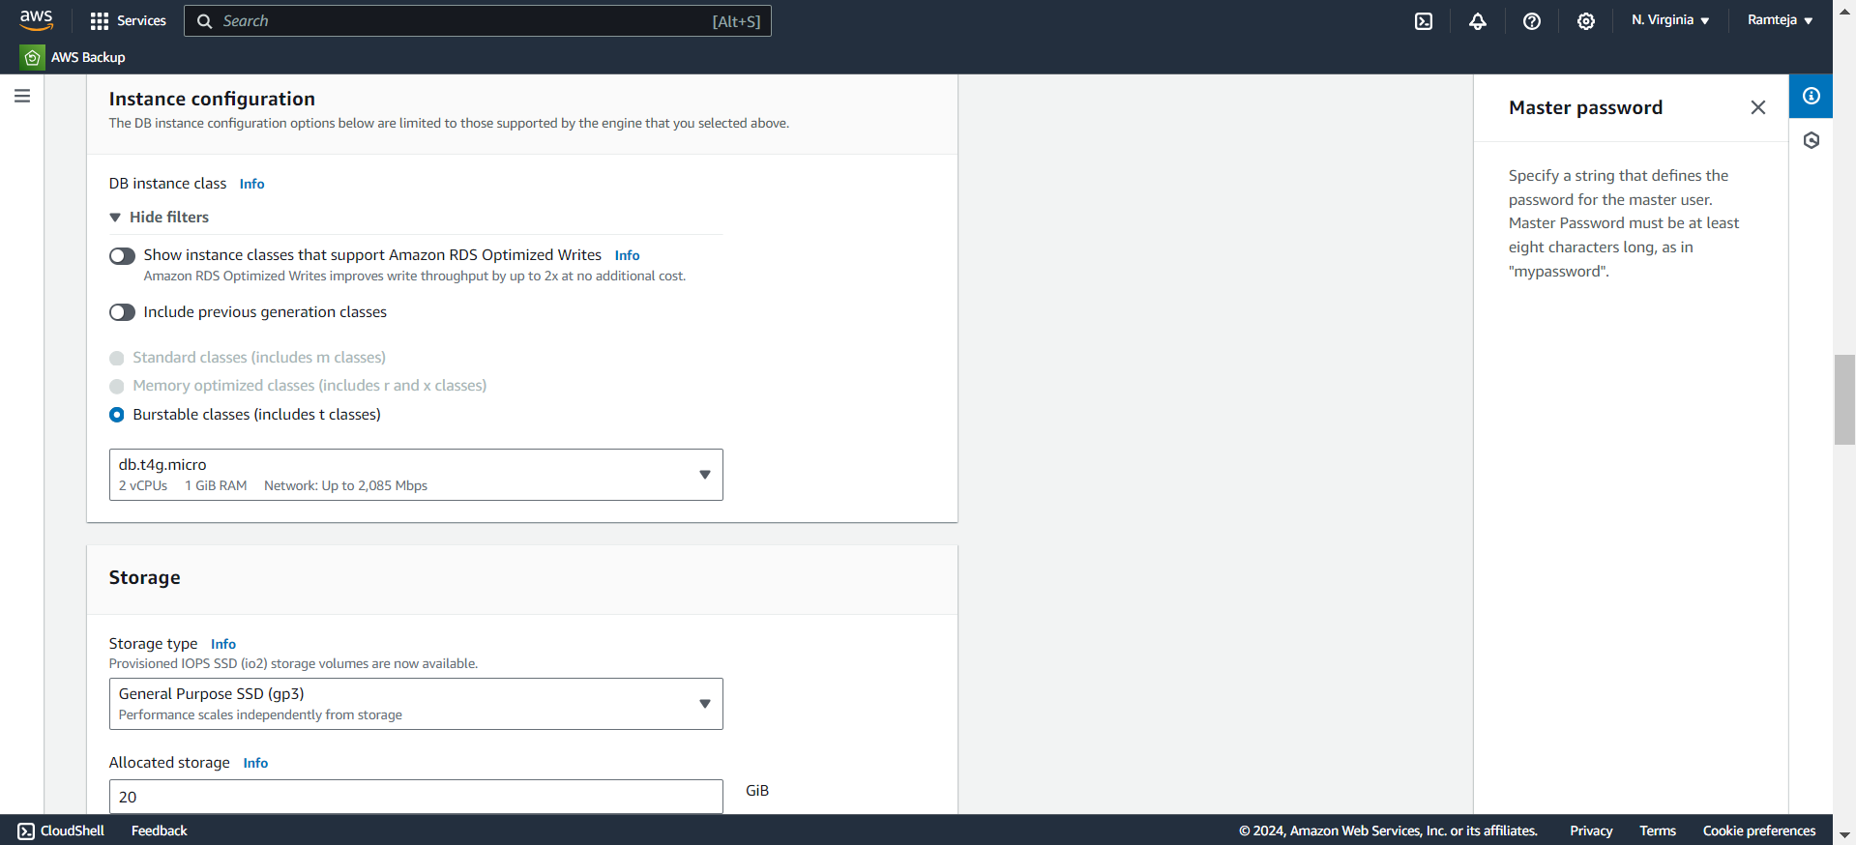
4.6 Select the Instance type & Storage.

Slide 54
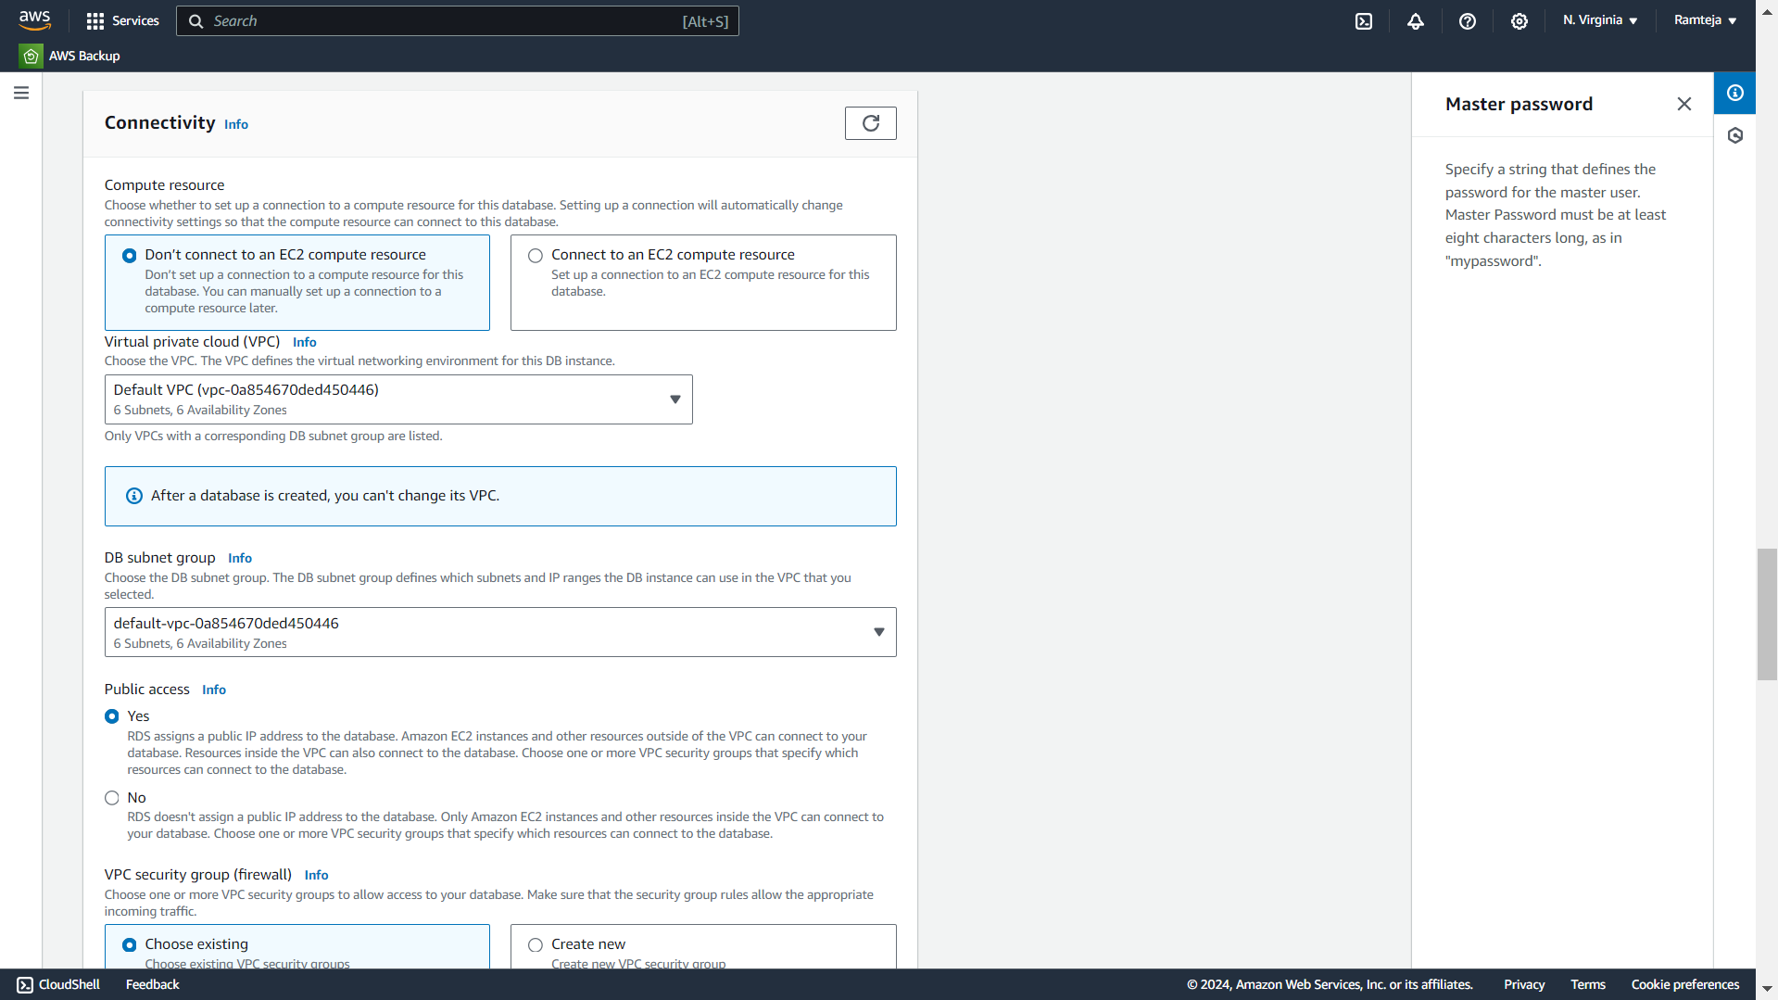
4.7 Select default VPC & Public Access as Yes.

Slide 55
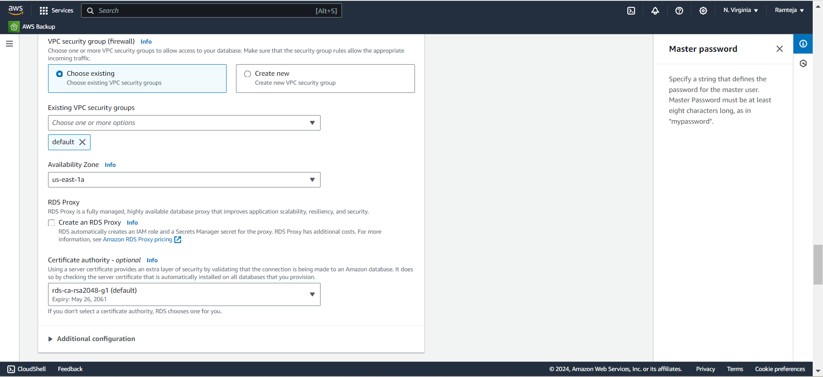
4.8 Select default Security Group & Availability Zone.

Slide 56
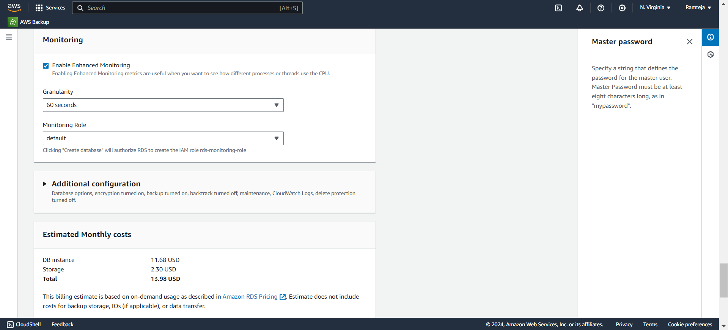
4.9 Enable Enhance Monitoring In Monitoring & Click on Create.

Slide 57
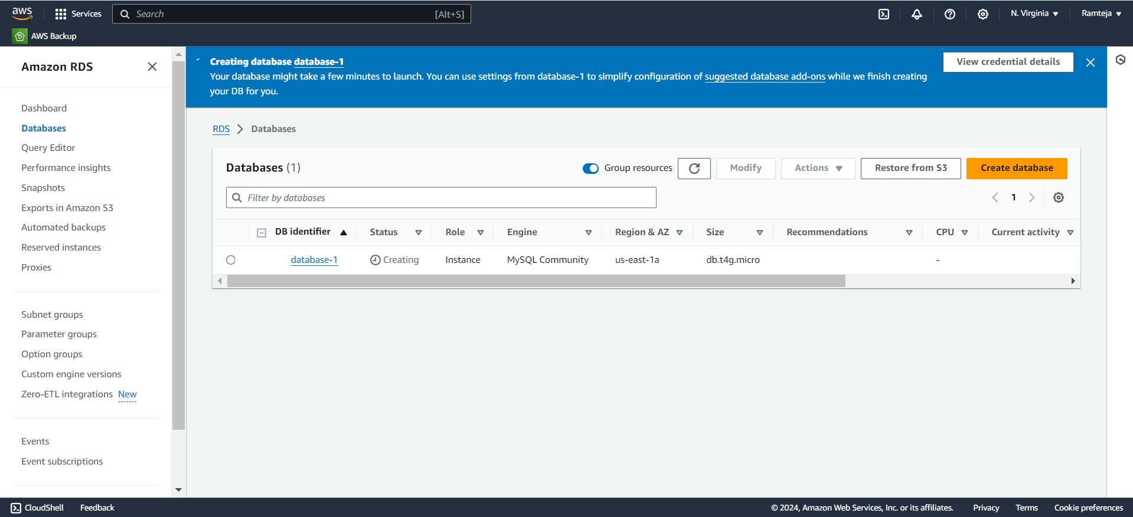
4.10 It will take a while to Create the Database.

Slide 58
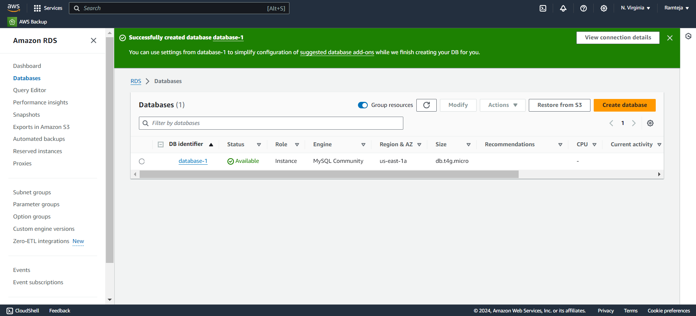
4.11 RDS Created Successfully.

Slide 59

4.12 Open the database & Click on VPC Security Group.

Slide 60

4.13 Open Security Group.

Slide 61

4.14 Click on edit Inbound rules.

Slide 62

4.15 Click on Add rule as Custom TCP with database port number.

Slide 63

4.16 Click on save to add the rule.

Slide 64

4.17 Copy the database endpoint.

Slide 65
5.DBeaver
1.Install DBeaver & Open.
2.Click on connect to database logo, Search for our Database Engine & Click Next.
3.Paste the Database Endpoint URL in Server Host, Enter the Username, Password & Click on Test Connection.
4.Click on ok & then Finish to Established Connection between RDS Database & Dbeaver.
5.Expand Database-1,Right Click on New Database & Enter Database name Click on ok.
6.Expand formdata1,Right click on it ,Select SQL editor & Open SQL Script.
7.To create a table in formdata1 database , copy the query1 in the script.
8.Run the SQL query , Table has been created & Expand the tables in formdata1 database.
9.To display the table Copy the query2 in the Script & Run the query then table is displayed.
10.Table is Created.

Slide 66
Query-1
CREATE TABLE users (
email VARCHAR(255) NOT NULL,
firstName VARCHAR(100),
lastName VARCHAR(100),
phone VARCHAR(15),
birthday DATE, position VARCHAR(100),
courseLevel VARCHAR(50),
timeSlot VARCHAR(50),
PRIMARY KEY (email)
);
Query-2
SELECT * FROM users;

Slide 67

5.1 Open Dbeaver & Click on connect to database logo.

Slide 68

5.2 Search for our Database Engine.

Slide 69

5.3 Paste the Database URL in Server Host , Click on Test Connection.

Slide 70

5.4 Click on ok & Click on Finish.

Slide 71

5.5 Connection Established between RDS Database & Dbeaver.

Slide 72

5.6 Expand the database-1 & Right click on Database.

Slide 73


5.7 Create New Database & Click on ok.

Slide 74

5.8 Expand New Database-”formdata1”.

Slide 75

5.9 Right Click on New database & Select Open SQL script.

Slide 76

5.10 Create a table in the database.

Slide 77

5.11 Run the Query to Create the User table in Database.

Slide 78

5.12 Expand Tables in formdata1 & Table created in database.

Slide 79

5.13 To display table write the following Query.

Slide 80

5.14 Run the Query & It displays the table.

Slide 81
6.Connecting Lambda to RDS
1. Edit the following data in the python Lambda.
DB_HOST = 'database-1.c748oseu4sqb.us-east-1.rds.amazonaws.com‘(database endpoint)
DB_PORT = 3306
DB_USER = 'admin'
DB_PASSWORD = 'mypassword'
DB_NAME = ‘formdata1'

Slide 82

6.1 Paste Database endpoint in DBHost & Deploy.

Slide 83

7.Fill the form 3 pics

Slide 84


Slide 85


Slide 86

7.1 The data entered in the form is displayed here.

Slide 87

7.2 The form is Filled many Customers.

Slide 88

7.3 Arranged in Ascending order of First Name.

Slide 89

7.4 Selected the Data That contains Course Level - Associate.

Slide 90
8.Monitoring
1.Monitoring Lambda Function
1. Cloud Watch Logs for Lambda.
2. Detailed information of Request from Website to RDS.
3. Some logs of Website taking Data Successfully.
4. Cloud Watch Metrics
2.Monitoring Database
1. RDS Logs & Events.
2. Cloud Watch Metrics of RDS.
3. Maintenance , Backup & Snapshots in RDS.

Slide 91

8.1.1 Cloud Watch Logs for Lambda-”qwert”.

Slide 92

8.1.2 Detailed information of the request from site to data store in RDS.

Slide 93

8.1.3 Some logs of Website taking Data Successfully.

Slide 94

8.1.4 CloudWatch Metrics.

Slide 95

8.2.1 RDS Logs & Events.

Slide 96

8.2.2 Cloud Watch Metrics of RDS.

Slide 97

8.2.3

Slide 98

8.2.4 Maintenance , Backup & Snapshots in RDS.

